Slide 1
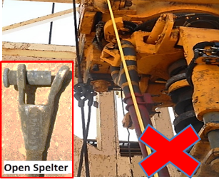
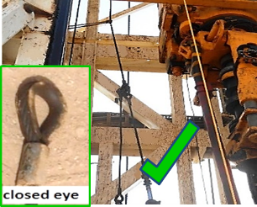
PDO Second Alert
Date: 22.05.2020 Incident title: HiPo#36
What happened?
Operation was RIH tubing with Down Hole Gauge cable. On joint no-4 after installing first & second cable bands, Asst. driller started to lower the string meanwhile Floor man was reaching out to lower the power tong simultaneously. Suddenly the Hydraulic tong fell on slips guard. The Hyd. Tong hang-off line had a short extension sling having open spelter on top connected to the tong hang-off line & hard eye on bottom connected to hyd. tong hanging cylinder. The Top Drive body caught the spelter, knocked out the spelter pin causing the tong to drop & land on Cavin slips guard. The hyd tong is NOV Gill 600 closed-end around the tubing. No Injury to anyone.
Your learning from this incident..
Always ensure TDS/Block path is always free from lines or obstruction.
Always pull and secure the power tong hang-off line away from TDS.
Always apply red-zone management: don’t attempt to lower the power tong while lowering string.
Always stop when there is an anticipated risk and communicate to the supervisor.
Ensure TDS/Block path is always free from lines or obstruction
Target Audience: Drilling, Operations, Logistics, Engineering & Construction
Notes:
Ensure all dates and titles are input
A short description should be provided without mentioning names of contractors or individuals. You should include, what happened, to who (by job title) and what injuries this resulted in. Nothing more!
Four to five bullet points highlighting the main findings from the investigation. Remember the target audience is the front line staff so this should be written in simple terms in a way that everyone can understand.
The strap line should be the main point you want to get across
The images should be self explanatory, what went wrong (if you create a reconstruction please ensure you do not put people at risk) and below how it should be done.

Slide 2
Management self audit
Date: 22.05.2020 Incident title: HiPo#36
As a learning from this incident and ensure continual improvement all contract
managers must review their HSE HEMP against the questions asked below
Confirm the following:
Do you ensure, the TDS path is always free from lines or obstruction?
Do you ensure, the proper red zone management?
Do you ensure, all critical equipment changes are captured in your MoC system?
Do you ensure, all crew understand the empowerment to STOP?
Do you ensure, all crew understands that practices can be challenged to avoid risk normalization?
* If the answer is NO to any of the above questions please ensure you take action to correct this finding.
Notes:
Ensure all dates and titles are input
Make a list of closed questions (only ‘yes’ or ‘no’ as an answer) to ask others if they have the same issues based on the management or HSE-MS failings or shortfalls identified in the investigation.
Imagine you have to audit other companies to see if they could have the same issues.
These questions should start with: Do you ensure…………………?

