Slide 1
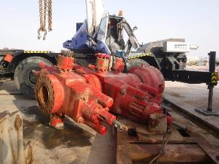
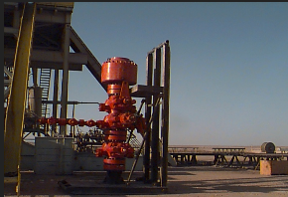
PDO Second Alert
Date: 05.06.2020 Incident title: HiPo#38
What happened?
On 05/06/2020 at 01:45 am, the crew started assembling 13-5/8” 10K BOP stack using the rig crane to prepare the assembly for offline pressure testing. After bolting together the crew removed the lifting slings and shackles from pad eyes to release the crane for the next task. Once removed from the lifting points, the crane operators started raising the block and chain slings. As he continued to raise the block, the slings caught on the upper ram bonnet locking screw which caused the BOP assembly to topple falling on the crane cabin which got crushed and damaged.
Your learning from this incident..
Always ensure JSA / lift plan has been reviewed and approved by a competent person.
Always ensure that a qualified supervisor is in place during the lifting operation.
Always ensure the procedures with JSA covers all the steps with their associated hazards/ risks / consequences and effective controls for the planned task, managing all changes involved.
Always follow MOC procedure if required.
Always ensure effective implementation of PTW system.
Always Intervene whenever any unsafe act / condition occurs.
Always use approved lifting plan and don’t deviate from the work instructions
Target Audience: Drilling, Operations, Logistics, Engineering & Construction
Notes:
Ensure all dates and titles are input
A short description should be provided without mentioning names of contractors or individuals. You should include, what happened, to who (by job title) and what injuries this resulted in. Nothing more!
Four to five bullet points highlighting the main findings from the investigation. Remember the target audience is the front line staff so this should be written in simple terms in a way that everyone can understand.
The strap line should be the main point you want to get across
The images should be self explanatory, what went wrong (if you create a reconstruction please ensure you do not put people at risk) and below how it should be done.

Slide 2
Management self audit
Date: 05.06.2020 Incident title: HiPo#38
As a learning from this incident and ensure continual improvement all contract
managers must review their HSE HEMP against the questions asked below
Confirm the following:
Do you ensure the effectiveness of the TBT conducted at the site so that it covers necessary steps identifying all hazards before the task with the required JSA/ TRIC/ Lift Plan?
Do you ensure that your critical lift plans has been approved by PDO lifting engineer?
Do you ensure a system in place where learning from incident are captured and review periodically along with the HEMP appropriateness?
Do you ensure the effective implementation of MOC process to cover the changes generated?
Do you ensure that leaders are setting example and intervening for any unsafe practice?
* If the answer is NO to any of the above questions please ensure you take action to correct this finding.
Notes:
Ensure all dates and titles are input
Make a list of closed questions (only ‘yes’ or ‘no’ as an answer) to ask others if they have the same issues based on the management or HSE-MS failings or shortfalls identified in the investigation.
Imagine you have to audit other companies to see if they could have the same issues.
These questions should start with: Do you ensure…………………?

