Slide 1
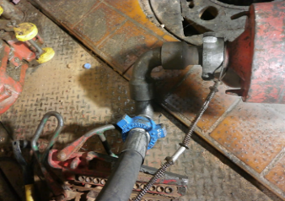
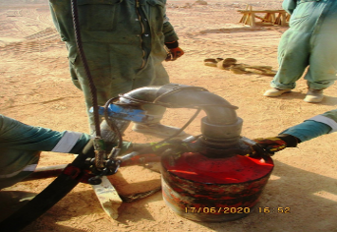
PDO Second Alert
Date: 14.06.2020 Incident title: HiPo#43
What happened?
At approximately, 01.35 hrs., During running 13 3/8” casing, drilling crew had difficulty to run the casing joint due to down hole restriction. Crew decided to wash down casing joint using circulating head and managed to run 4 joints successfully till they reached last joint to be run when circulating head suddenly disconnected causing swivel joint, circulating hose and circulating head to drop from top of casing joint to rig floor landing near the rotary table towards the V Door.
Your learning from this incident..
Always ensure two (2) chain tongs are used for makeup circulating head.
Always ensure you properly install secondary retention on circulating Assembly.
Always ensure your SOP include connection back off precautions.
Always ensure critical tasks are supervised by Tool pusher/ Night pusher.
Always ensure connections are made up to maximum torque.
Always ensure dynamic risk are assessed and proper safety controls are in place.
Always Secure Circulating Assembly with Secondary Retention
Target Audience: Drilling, Operations, Logistics, Engineering & Construction
Notes:
Ensure all dates and titles are input
A short description should be provided without mentioning names of contractors or individuals. You should include, what happened, to who (by job title) and what injuries this resulted in. Nothing more!
Four to five bullet points highlighting the main findings from the investigation. Remember the target audience is the front line staff so this should be written in simple terms in a way that everyone can understand.
The strap line should be the main point you want to get across
The images should be self explanatory, what went wrong (if you create a reconstruction please ensure you do not put people at risk) and below how it should be done.

Slide 2
Management self audit
Date: 14.06.2020 Incident title: HiPo#43
As a learning from this incident and ensure continual improvement all contract
managers must review their HSE HEMP against the questions asked below
Confirm the following:
Do you ensure that proper Work planning takes place including preparation and verification of required tools.
Do you ensure that SOP/ JSA as available or all operations including contingency plans
Do you ensure that your employees are conducting proper risk assessment whenever SOP is not clear / not available.
Do you ensure that all Dynamic and Static Drop Object Prevention requirements are followed by your respective team.
* If the answer is NO to any of the above questions please ensure you take action to correct this finding.
Notes:
Ensure all dates and titles are input
Make a list of closed questions (only ‘yes’ or ‘no’ as an answer) to ask others if they have the same issues based on the management or HSE-MS failings or shortfalls identified in the investigation.
Imagine you have to audit other companies to see if they could have the same issues.
These questions should start with: Do you ensure…………………?

