Slide 1
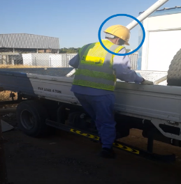
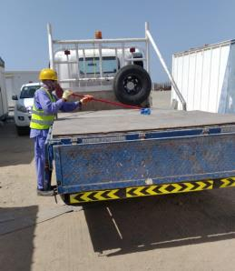
PDO Second Alert
Date: 09.05.2020 Incident: LTI#09, R Wrist Injury
What happened?
Mason was to clean gravel from the back of a 4t Truck, he tried accessing the bed of the truck by climbing over the closed side gates of the truck. On doing so he hit his head on a diagonal pole lost his balance and fell to the ground causing a fracture to this right wrist
Your learning from this incident..
Always ensure that you understand the hazards and risks in your workplace
Always ensure that you only access the bed of a truck when absolutely necessary, think before you act
Always ensure that the correct means of access/egress to a flat bed of a truck is safe
Always ensure that you understand all aspects of the project even if the task seems trivial or common a practice.
Always ensue that Supervision is available to advise you on the work
Always ensure that you stay focused on your work and that you do not put yourself at risk at any time.
Work Smart! – Think before you Start
Target Audience: Drilling, Operations, Logistics, Engineering & Construction
Notes:
Ensure all dates and titles are input
A short description should be provided without mentioning names of contractors or individuals. You should include, what happened, to who (by job title) and what injuries this resulted in. Nothing more!
Four to five bullet points highlighting the main findings from the investigation. Remember the target audience is the front line staff so this should be written in simple terms in a way that everyone can understand.
The strap line should be the main point you want to get across
The images should be self explanatory, what went wrong (if you create a reconstruction please ensure you do not put people at risk) and below how it should be done.

Slide 2
Management self audit
Date: 09.05.2020 Incident: LTI#09, R Wrist Injury
As a learning from this incident and ensure continual improvement all contract
managers must review their HSE HEMP against the questions asked below
Confirm the following:
Do you ensure that you have capture all working processes in the HSE project plan?
Do you ensure that all hazard and risks have been identified and communicated to the workforce?
Do you ensure that you have adequate supervision on site?
Do you ensure that you reflective learning is embraced and understood by the work force?
Do you ensure that the correct equipment is available and applicable for the task at hand?
Do you ensure that staff are focused on the work and not left to ‘daydream’?
If the answer is NO to any of the above questions please ensure you take action to correct this finding.
Notes:
Ensure all dates and titles are input
Make a list of closed questions (only ‘yes’ or ‘no’ as an answer) to ask others if they have the same issues based on the management or HSE-MS failings or shortfalls identified in the investigation.
Imagine you have to audit other companies to see if they could have the same issues.
These questions should start with: Do you ensure…………………?

