Slide 1
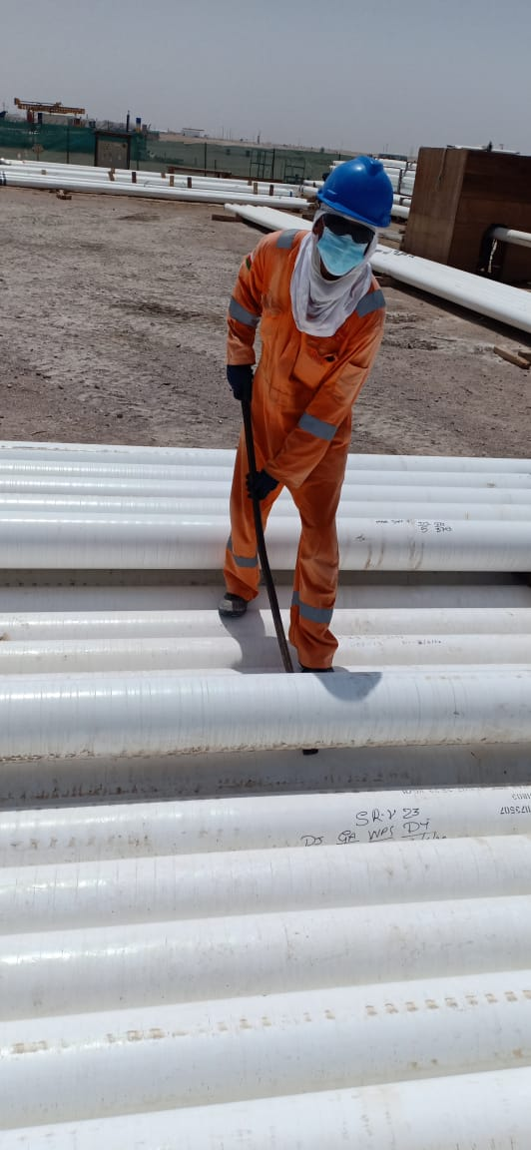
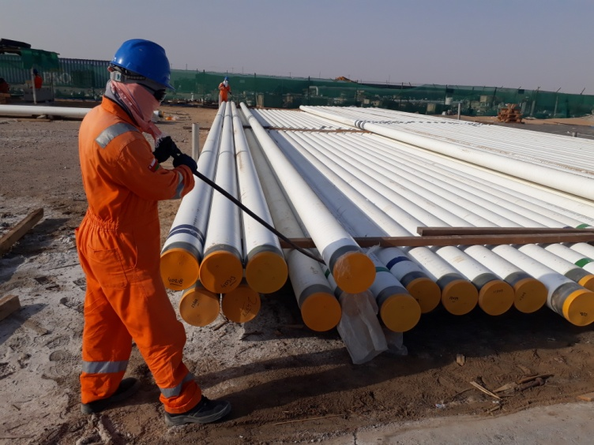
PDO Second Alert
Date: 30.06.2020 Incident title : LTI#12, R Ankle Injury
What happened?
Technician was rolling the pipes in industrial doubling yard by using a crow
bar. while rolling the pipe, the unsecured pipe from behind him slid and
rested on his right leg causing ankle fracture.
Your learning from this incident..
Always following the correct safe material handling method.
Always consult supervisor before carrying out activity.
Always ensure proper support provided in between pipes in pipe stacking rack.
Always Ensure you identify all hazards before starting a task.
Always discuss all hazards during TBT and mark TRIC Card.
Supervisor to discuss the hazards and risks specific to the activity and ensure crew is familiar with the precautions.
Discuss potential “line of fire’’ scenarios in HSE meetings.
Target Audience: Drilling, Operations, Logistics, Engineering & Construction
Notes:
Ensure all dates and titles are input
A short description should be provided without mentioning names of contractors or individuals. You should include, what happened, to who (by job title) and what injuries this resulted in. Nothing more!
Four to five bullet points highlighting the main findings from the investigation. Remember the target audience is the front line staff so this should be written in simple terms in a way that everyone can understand.
The strap line should be the main point you want to get across
The images should be self explanatory, what went wrong (if you create a reconstruction please ensure you do not put people at risk) and below how it should be done.

Slide 2
Management self audit
Date: 30.06.2020 Incident title : LTI#12, R Ankle Injury
As a learning from this incident and ensure continual improvement all contract
managers must review their HSE HEMP against the questions asked below
Confirm the following:
1) Do you ensure that your supervisors engage workforce in planning the work ?
2) Do you ensure that the method statement is available and used for right task ?
3) Do you ensure that crew conducting dynamic risk review effectively ?
4) Do you ensure that management discuss BBS data and how site are analysing near miss event?
5) Does the management encourage two way discussion in HSE meetings?
6) Do Auditors question workforce during L3 audits to understand the improvement by LFIs?
* If the answer is NO to any of the above questions please ensure you take action to correct this finding.
Notes:
Ensure all dates and titles are input
Make a list of closed questions (only ‘yes’ or ‘no’ as an answer) to ask others if they have the same issues based on the management or HSE-MS failings or shortfalls identified in the investigation.
Imagine you have to audit other companies to see if they could have the same issues.
These questions should start with: Do you ensure…………………?

