Slide 1
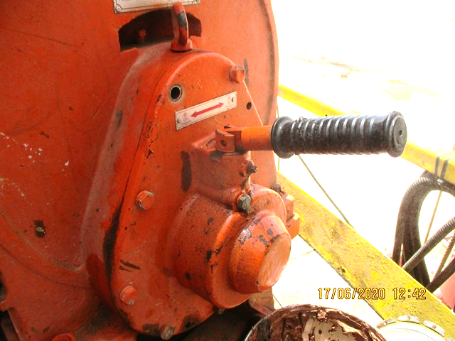
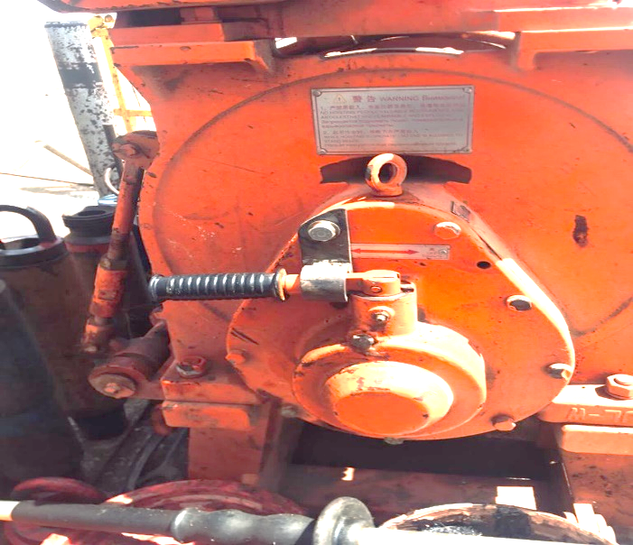
PDO Second Alert
Date: 16.06.2020 Incident title: HiPo#46
What happened?
At approximately 02:06 AM on 16th June 2020 during making connection, Roustabout (winch operator) was lifting the DP from the catwalk and floor crew heard a noise from air winch subsequently the Roustabout stopped the winching and applied the brake. Whilst checking the winch the crew found that the lever operated on-off switch which engages or disengages the gear (quick release) is being moved slightly into mid position. Driller put the lever to “off” position instead of “on” position and asked the Roustabout to operate the winch. When the Roustabout release the brake to continue winching, the Drill pipe slid back to catwalk with winch line.
Your learning from this incident..
Always ensure competent and experienced personnel are operating the winch.
Always ensure adequate training is provided to the crew on operating the winch.
Always ensure SOP covers the quick release hazard of winch.
Always ensure locking mechanism is installed on the winch switch to prevent accidental movement.
Never operate any control switches without knowing its function.
Always ensure the trained personnel are operating the winch
Target Audience: Drilling, Operation, Engineering, Exploration & construction
Notes:
Ensure all dates and titles are input
A short description should be provided without mentioning names of contractors or individuals. You should include, what happened, to who (by job title) and what injuries this resulted in. Nothing more!
Four to five bullet points highlighting the main findings from the investigation. Remember the target audience is the front line staff so this should be written in simple terms in a way that everyone can understand.
The strap line should be the main point you want to get across
The images should be self explanatory, what went wrong (if you create a reconstruction please ensure you do not put people at risk) and below how it should be done.

Slide 2
Management self audit
Date: 16.06.2020 Incident title: HiPo#46
As a learning from this incident and ensure continual improvement all contract
managers must review their HSE HEMP against the questions asked below
Confirm the following:
Do you ensure competent and experienced personnel are operating the winch?
Do you ensure adequate training is provided to the crew on operating the winch?
Do you ensure SOP covers the full operation hazard of winch?
Do you ensure locking mechanism is installed on the winch switch to prevent accidental movement?
* If the answer is NO to any of the above questions please ensure you take action to correct this finding.
Notes:
Ensure all dates and titles are input
Make a list of closed questions (only ‘yes’ or ‘no’ as an answer) to ask others if they have the same issues based on the management or HSE-MS failings or shortfalls identified in the investigation.
Imagine you have to audit other companies to see if they could have the same issues.
These questions should start with: Do you ensure…………………?

