Slide 1
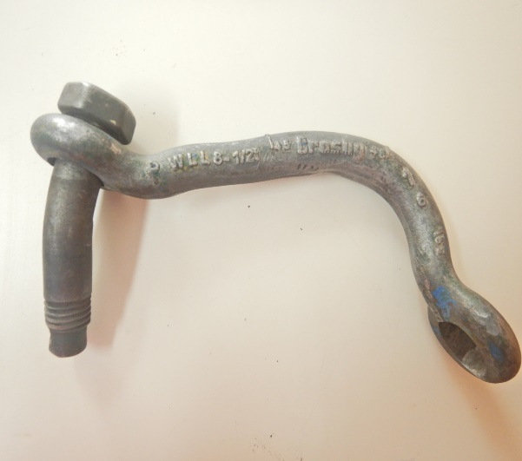
PDO Second Alert
Date: 18.06.2020 Incident title: HiPo#47
What happened?
On 18 June 2020, operation was RIH and wash down 13 3/8” CSG, last two 2m from shoe depth, observed sudden shoot in press and lost circulation. After confirming that DAS laflure has failed, decided to break the joint and lay down joint using circulation sub. While attempting to break with power tong, operator gave signal to wench operator (FM) to p/up tong. Driller though signal was given to him & attempt to P/up csg joint ahead of time (joint was still not disconnected). Results in having o/pull on Single Joint Elevator (SJE) where Shackle (1” size) between Swivel and slings got deformed/ disconnected and fall on rig floor, close to Draw work around 4.5m from rotary. Luckily, DAS operator moved just before SJE and two slings drop and rest on power tong. No injuries.
Your learning from this incident..
Always maintain proper communication & clear signaling even when perceived operational risk is pushing you to act quickly.
Always ensure your casing joint is fully backout before instructing to pickup on draw works.
Always ensure the driller re-sets the upper weight indicator limit before laying down casing.
Always ensure to respect no-go zone.
Shackle stripped out and dropped in front of draw work
Always maintain proper communication & clear signaling
Always maintain proper communication & clear signaling
Target Audience: Drilling, Logistics, Operation, Engineering, Exploration & construction
Notes:
Ensure all dates and titles are input
A short description should be provided without mentioning names of contractors or individuals. You should include, what happened, to who (by job title) and what injuries this resulted in. Nothing more!
Four to five bullet points highlighting the main findings from the investigation. Remember the target audience is the front line staff so this should be written in simple terms in a way that everyone can understand.
The strap line should be the main point you want to get across
The images should be self explanatory, what went wrong (if you create a reconstruction please ensure you do not put people at risk) and below how it should be done.

Slide 2
Management self audit
Date: 18.06.2020 Incident title: HiPo#47
As a learning from this incident and ensure continual improvement all contract
managers must review their HSE HEMP against the questions asked below
Confirm the following:
Do you ensure effective dynamic risk review during TBTs & adequate task supervision?
Do you ensure regular update of operating standard & procedure ?
Do you ensure effective communication while carrying out critical operation?
Do you ensure always to confirm casing joint is completely disconnected before P/U with SJE?
* If the answer is NO to any of the above questions please ensure you take action to correct this finding.
Notes:
Ensure all dates and titles are input
Make a list of closed questions (only ‘yes’ or ‘no’ as an answer) to ask others if they have the same issues based on the management or HSE-MS failings or shortfalls identified in the investigation.
Imagine you have to audit other companies to see if they could have the same issues.
These questions should start with: Do you ensure…………………?

