Slide 1
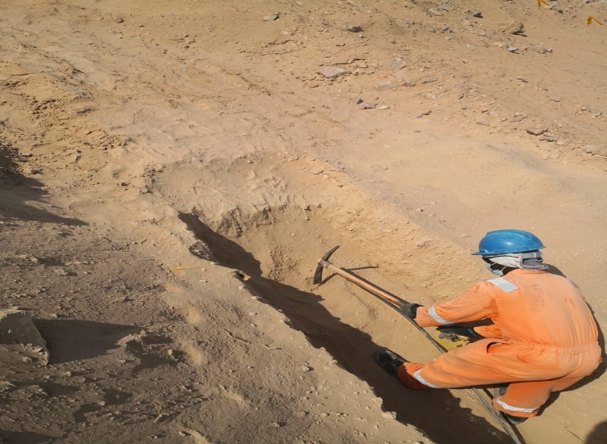
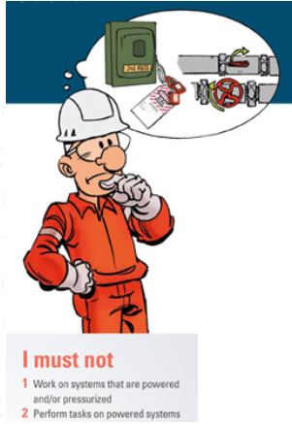
PDO Second Alert
Date:30.06.2020 Incident title : HiPo#49
What happened?
A civil technician cut a exposed cable inside the trench assuming it to be a redundant one, permit holder also did not verify the cable status before giving the permission.
Your learning from this incident..
Comply with the PTW requirements.
Follow the procedure and STOP the job if it is unsafe.
Never take decisions on assumptions and consult supervisors.
Use empowerment and say ‘’NO’’ to unsafe work.
Consult Permit Applicant and carryout DRA incase of any change.
Never try to cut any exposed cable, inform electrical team for assistance.
Say No if it not your Job !!!
Target Audience: Logistics, Operation, Engineering, Exploration & construction
Notes:
Ensure all dates and titles are input
A short description should be provided without mentioning names of contractors or individuals. You should include, what happened, to who (by job title) and what injuries this resulted in. Nothing more!
Four to five bullet points highlighting the main findings from the investigation. Remember the target audience is the front line staff so this should be written in simple terms in a way that everyone can understand.
The strap line should be the main point you want to get across
The images should be self explanatory, what went wrong (if you create a reconstruction please ensure you do not put people at risk) and below how it should be done.

Slide 2
Management self audit
Date:30.06.2020 Incident title : HiPo#49
As a learning from this incident and ensure continual improvement all contract
managers must review their HSE HEMP against the questions asked below
Confirm the following:
Do you ensure HSE inspections conducted on safety critical activities ?
Do you ensure your supervisor fully aware about their responsibilities ?
Does the management encourage manpower to practice empowerment to Stop?
Do the workers understand the types of Hazards during the excavation activity ?
Does the management facilitate hazard awareness training for workers ?
Does PA visit site as per permit requirement ?
Do you ensure workers follow PTW requirements and comply with LSRs ?
Do PHs carryout dynamic risk assessment as and when required and record it ?
* If the answer is NO to any of the above questions please ensure you take action to correct this finding.
Notes:
Ensure all dates and titles are input
Make a list of closed questions (only ‘yes’ or ‘no’ as an answer) to ask others if they have the same issues based on the management or HSE-MS failings or shortfalls identified in the investigation.
Imagine you have to audit other companies to see if they could have the same issues.
These questions should start with: Do you ensure…………………?

