Slide 1
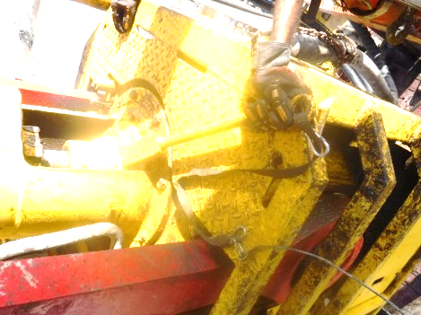
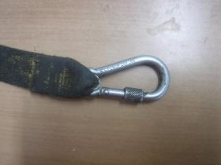
PDO Second Alert
Date: 28.08.2020 Incident title: HiPo#53
What happened?
On 28th July 2020. Operation: Replacing TDS wash pipe from stabbing board level. At 10:43hrs, Derrick man (DM) placed the wash pipe wrench in position and gave signal to the driller to rotate in controlled manner to change the wrench orientation to allow access for hammering. DM and FLM moved out of the Line of fire. During the rotation for alignment, the wrench slipped from wash pipe hammer union and came off due to the failure of the secondary retention and fell on the rig floor inside the controlled red zone. . Height of the fall of wrench is 5 meters and the weight of the wrench is Approx. 7Kg. No Injury to person reported and no damage to property.
Your learning from this incident..
Always use screw type carabiner (double lock mechanism) for working at height – secondary retention slings.
Ensure that no rotation of the TDS to aligned the hammer nut when wrench installed.
Ensure DROPS focal point always inspect the tools and verify the tools used are correct, prior to taking it to height.
Ensure non-compliant DROPS tools are not kept inside DROPS toolbox.
Always ensure, In case of doubt, STOP and consult the base management for further advice.
Always follow the plan/RA devised during the planning/TBT stage.
Wrong type of secondary retention sling used for securing tools at height – Single action carabiners
Correct type of secondary retention sling with screw type carabiner – Double locking mechanism
Always use correct retention tools at height and never rotate wash pipe with wrench.
Target Audience: Drilling, Logistics & construction
Notes:
Ensure all dates and titles are input
A short description should be provided without mentioning names of contractors or individuals. You should include, what happened, to who (by job title) and what injuries this resulted in. Nothing more!
Four to five bullet points highlighting the main findings from the investigation. Remember the target audience is the front line staff so this should be written in simple terms in a way that everyone can understand.
The strap line should be the main point you want to get across
The images should be self explanatory, what went wrong (if you create a reconstruction please ensure you do not put people at risk) and below how it should be done.

Slide 2
Management self audit
Date: 28.08.2020 Incident title: HiPo#53
As a learning from this incident and ensure continual improvement all contract
managers must review their HSE HEMP against the questions asked below
Confirm the following:
Do you ensure your Rig Management (Toolpusher) intervein and address unsafe behavior and unsafe practices?
Do you ensure that TDS never rotated to aligned the hammer nut when wrench installed?
Do you ensure non-compliant DROPS tools are not kept inside DROPS toolbox?
Do you ensure that the plan/RA revised during the planning/TBT stage and followed?
Do you ensure that the DROPS focal point always inspect the tools and ensure the tools used are correct, prior to taking it to height?
* If the answer is NO to any of the above questions please ensure you take action to correct this finding.
Notes:
Ensure all dates and titles are input
Make a list of closed questions (only ‘yes’ or ‘no’ as an answer) to ask others if they have the same issues based on the management or HSE-MS failings or shortfalls identified in the investigation.
Imagine you have to audit other companies to see if they could have the same issues.
These questions should start with: Do you ensure…………………?

