Slide 1
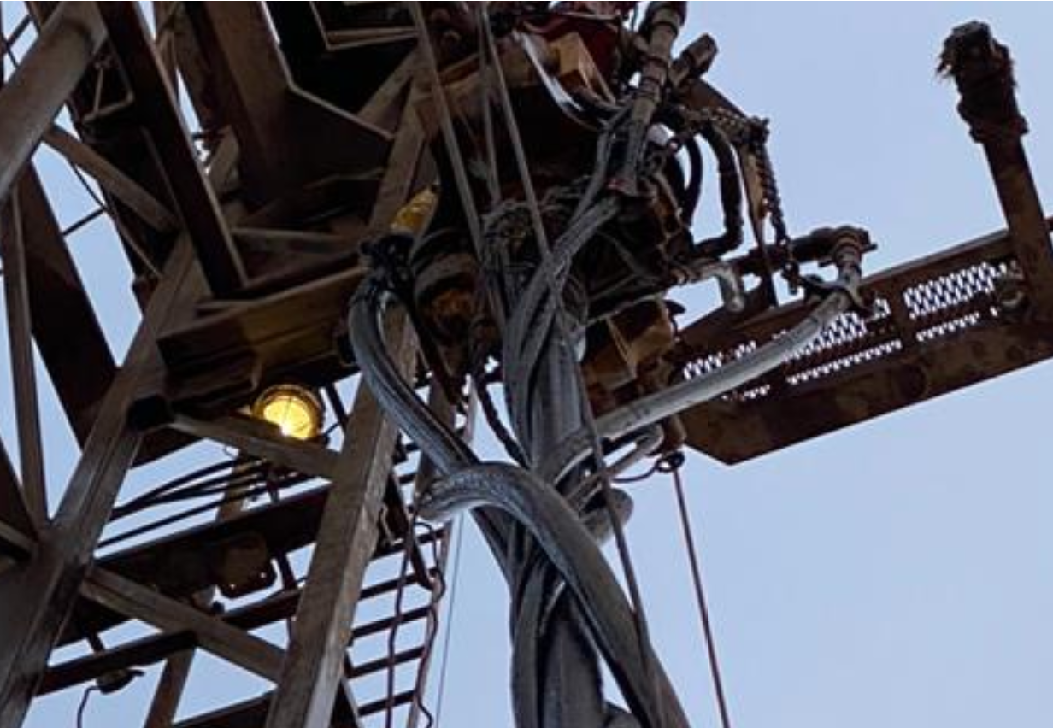
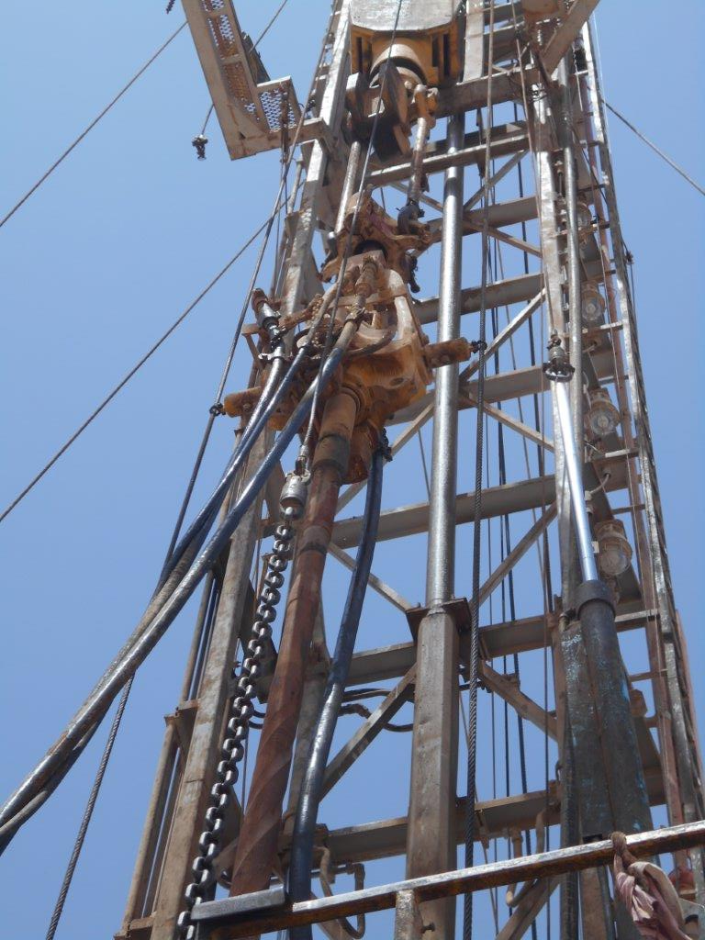
PDO Second Alert
Date: 20.03.2020 Incident title HVL#06
What happened?
20/03/20 at about 6:20hrs Driller had raised one full joint to break out and lay the joint down with the power swivel. In the process of breaking the joint out, the connection was not moving, so the Driller, while watching the power swivel control and torque gauges, applied additional torque, not noticing the reaction of the swivel. The power swivel reacting to the torque exceeded the torque rein set up holding capacity and started to counter turn. During the process that lasted for only a few seconds, the swivel body rotated about 1 complete turn, wrapping up of the lines and hoses.
Your learning from this incident..
Ensure toolbox talks cover immediate operations with sufficient detail.
Ensure power swivel torque reins are rigged up and pre-tensioned as per OEM.
Ensure to refer to the SOP even though job has been completed many times before.
Ensure power swivel torque reins are rigged up and pre-tensioned as per OEM
Target Audience: Drilling, Logistics, Operation & construction
Notes:
Ensure all dates and titles are input
A short description should be provided without mentioning names of contractors or individuals. You should include, what happened, to who (by job title) and what injuries this resulted in. Nothing more!
Four to five bullet points highlighting the main findings from the investigation. Remember the target audience is the front line staff so this should be written in simple terms in a way that everyone can understand.
The strap line should be the main point you want to get across
The images should be self explanatory, what went wrong (if you create a reconstruction please ensure you do not put people at risk) and below how it should be done.

Slide 2
Management self audit
Date: 20.03.2020 Incident title HVL#06
As a learning from this incident and ensure continual improvement all contract
managers must review their HSE HEMP against the questions asked below
Confirm the following:
Do you ensure that your SOP covers making and breaking connection with the power swivel?
Do you ensure that your SOP covers correct tension of the torque reins?
Do you ensure that your crews refer to the SOP and hold a correct TBT?
Do you ensure that the site supervisor validate equipment configuration?
Do you feed back to your Contract Holder to validate any corrective action from lateral and shared learnings have been completed?
Do you refer to the library of 1st and 2nd alerts to ensure that shared learnings have not been missed?
* If the answer is NO to any of the above questions please ensure you take action to correct this finding.
Notes:
Ensure all dates and titles are input
Make a list of closed questions (only ‘yes’ or ‘no’ as an answer) to ask others if they have the same issues based on the management or HSE-MS failings or shortfalls identified in the investigation.
Imagine you have to audit other companies to see if they could have the same issues.
These questions should start with: Do you ensure…………………?

