Slide 1
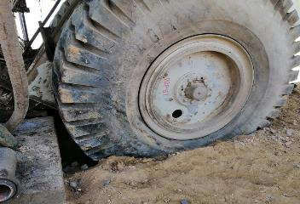
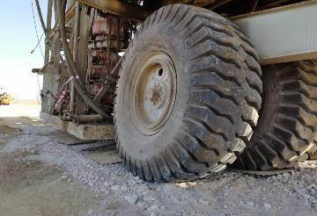
PDO Second Alert
Date: 28.04.2020 Incident title HVL#07
What happened?
While moving the rig, it got stuck two times because of the road conditions which had been affected by heavy rain in the area. In the result of the first stuck, the rig was successfully recovered with no any damage to the rig structure integrity. During the second stuck event, the rig structure leant towards Driller’s side until the subbase hit the ground. In the result of the impact the weight shifted towards the mast cradle causing the damage of horizontal and vertical beams of the mast.
Your learning from this incident..
Always assess the risks to address adequate control measures.
Always stop to identify hazards of the operations before starting work.
Always intervene and use SWA if safety is concerned.
Always use approved safe work methods.
Always be prepared for the environment you are working in and be prepared for unexpected events.
Always use steel plates to overcome suspected underground water zones during the rig move.
Always build roads in accordance with standards and take weather conditions into consideration
Target Audience: Drilling, Operations, Logistics, Exploration, Engineering & Construction
Notes:
Ensure all dates and titles are input
A short description should be provided without mentioning names of contractors or individuals. You should include, what happened, to who (by job title) and what injuries this resulted in. Nothing more!
Four to five bullet points highlighting the main findings from the investigation. Remember the target audience is the front line staff so this should be written in simple terms in a way that everyone can understand.
The strap line should be the main point you want to get across
The images should be self explanatory, what went wrong (if you create a reconstruction please ensure you do not put people at risk) and below how it should be done.

Slide 2
Management self audit
Date: 28.04.2020 Incident title HVL#07
As a learning from this incident and ensure continual improvement all contract
managers must review their HSE HEMP against the questions asked below
Confirm the following:
Do you ensure that there is adequate process for rig move road handover?
Do you ensure that all factors (rain, wadi, rig weight etc.) are taken into consideration while preparing roads for rig move?
Do you ensure that there is adequate system for LFI?
Do you ensure that corrective actions are being developed based on the in-depth risk assessment?
Do you ensure that you are prepared for emergencies and recovery?
Do you ensure that verification protocols are independent and unbiased?
Do you ensure that all parties are informed of all potential failures and involved into the pre-rig move discussion ?
Do you ensure that your task related procedures are up to date and address all aspects?
* If the answer is NO to any of the above questions please ensure you take action to correct this finding.
Notes:
Ensure all dates and titles are input
Make a list of closed questions (only ‘yes’ or ‘no’ as an answer) to ask others if they have the same issues based on the management or HSE-MS failings or shortfalls identified in the investigation.
Imagine you have to audit other companies to see if they could have the same issues.
These questions should start with: Do you ensure…………………?

