Slide 1
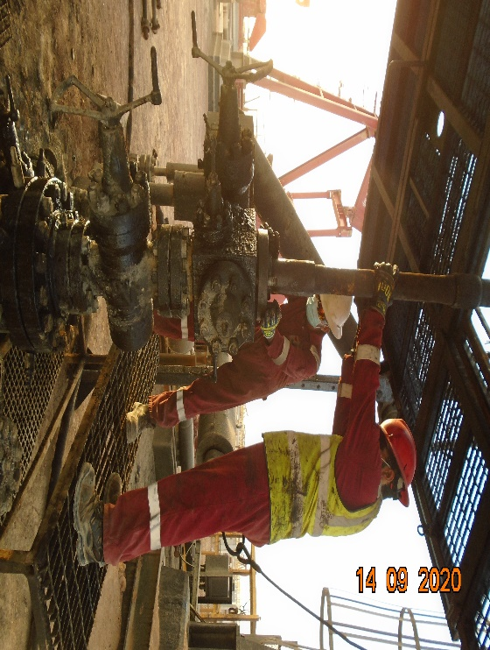
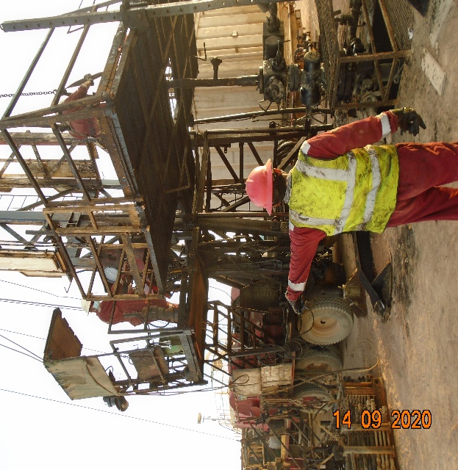
PDO Second Alert
Date: 14.09.2020 Incident title : LTI#22, Finger Injury
What happened?
While attempting to align sucker rod BOP flange over the X-mas tree,
Floorman placed his hand underneath the flange and while doing so the
flange unexpectedly shifted downwards and caught the employee’s right
hand ring finger in between the flange and X-mas tree plate causing a
Fracture.
Your learning from this incident..
ALWAYS intervene and exercise STOP Work Authority.
ALWAYS plan the task and ensure adequate pre-job brief is done including for routine tasks.
ALWAYS ensure you use updated SOP for the task.
ALWAYS maintain clear communication during the task.
ALWAYS wear PPE.
ALWAYS stay away from LOF.
ALWAYS ensure that Supervisor is supervising & is not performing the task himself
Target Audience: Drilling, Operation, Engineering
Notes:
Ensure all dates and titles are input
A short description should be provided without mentioning names of contractors or individuals. You should include, what happened, to who (by job title) and what injuries this resulted in. Nothing more!
Four to five bullet points highlighting the main findings from the investigation. Remember the target audience is the front line staff so this should be written in simple terms in a way that everyone can understand.
The strap line should be the main point you want to get across
The images should be self explanatory, what went wrong (if you create a reconstruction please ensure you do not put people at risk) and below how it should be done.

Slide 2
Management self audit
Date: 14.09.2020 Incident title : LTI#22, Finger Injury
As a learning from this incident and ensure continual improvement all contract
managers must review their HSE HEMP against the questions asked below
Confirm the following:
Do you ensure that there is sufficient assurance processes from country leadership team to verify compliance with HSE standards?
Do you ensure that field personnel have understanding of STOP Work Authority and their responsibilities and have all required resources and support to exercise it when needed?
Do you ensure that field personnel have adequate skills to recognize dynamic pinch points?
Do you ensure that all lifting activities are performed in accordance with SP 2273?
Do you ensure that SOPs are available for all tasks and are being reviewed prior to the job?
Do you ensure that CCTV reviews are capturing the compliance to SOPs?
Do you ensure that all tasks are pre-followed by formal risk assessment?
Do you ensure that Supervisors are supervising?
* If the answer is NO to any of the above questions please ensure you take action to correct this finding.
Notes:
Ensure all dates and titles are input
Make a list of closed questions (only ‘yes’ or ‘no’ as an answer) to ask others if they have the same issues based on the management or HSE-MS failings or shortfalls identified in the investigation.
Imagine you have to audit other companies to see if they could have the same issues.
These questions should start with: Do you ensure…………………?

