Slide 1
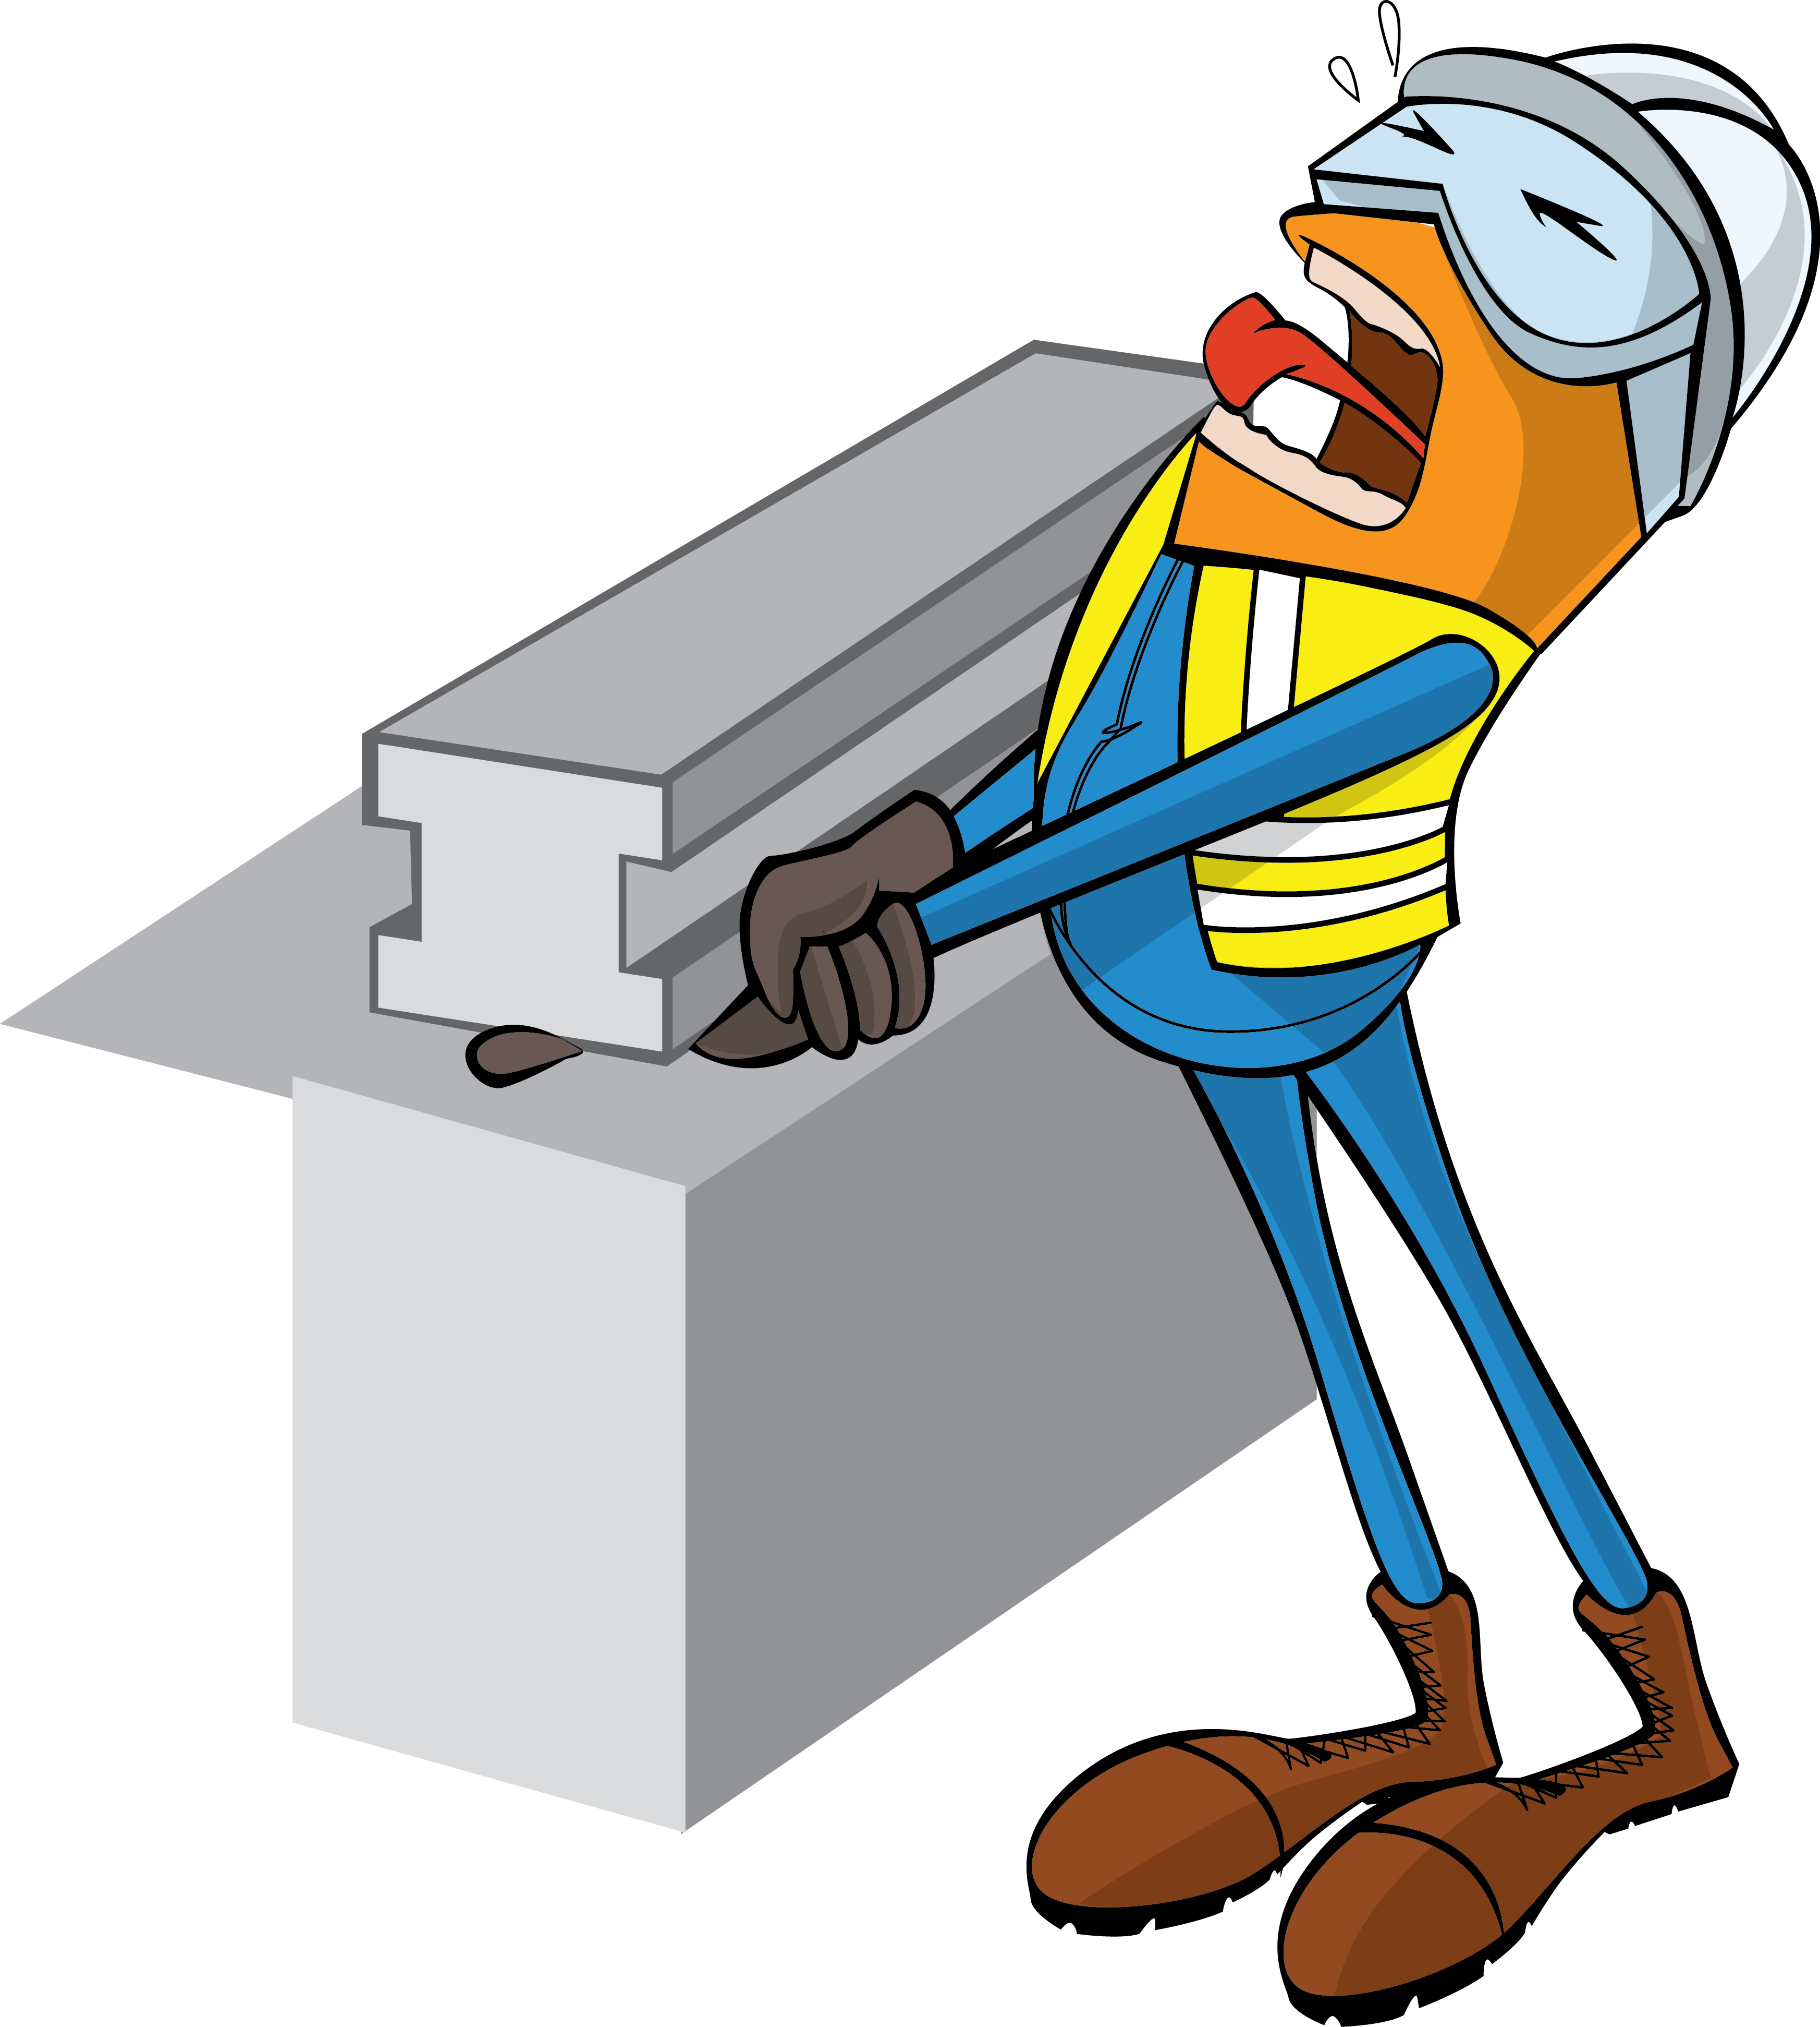
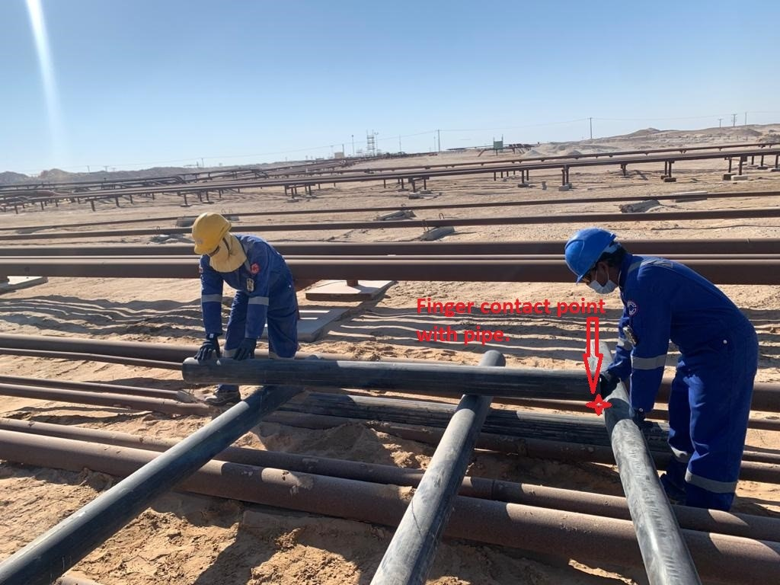
PDO Incident First Alert - AHPS
Incident Type | LTI#05 | Pattern | Hands and Fingers
Date / Time | 18.01.2021@15:10hrs | Directorate | Project Delivery
Location | Yibal | Dept | PDC
Target Audience
Drilling, Operations, Engineering, Logistic & Construction
What happened
While the Helper was shifting the scrap pipes, his right little finger pinched between two pipes causing an injury.
Mr. Musleh asks the questions of can it happen to you?
Do you ensure you identify all hazards before starting a task?
Do you ensure you keep your hands and fingers away from pinch points?
How do you ensure your Hands & Fingers are away from ‘Line of Fire’?
Do you report all incidents immediately?
Pinch point
Please disseminate this LTI notification to your teams and use it in your tool box talks and HSE meetings and notice boards.
“This document is restricted and it is distributed for information purposes only and it shall not be shared with other than PDO employees and contracts without PDO permission”.

