Slide 1
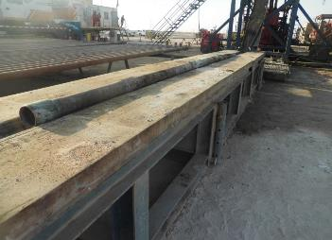
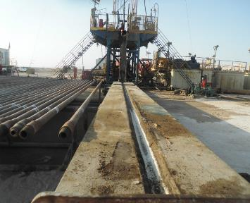
PDO Second Alert
Date:04.10.2020 Incident title: LTI#25, Leg Injury
What happened?
On the 4th of October 2020 at approximately 12:30 noon while Slick line team was preparing to rig up lubricator at Hoist Location. After make/up of lubricator by Slickline crew, the lubricator was being lifted by driller using the hoist winch and mobile crane, the elevated end of the swung to the pipe-rack side of the catwalk and got in contact with a 4 ½” Landing joint (4 meters long) which was laying on the catwalk. Landing joint rolled off the catwalk and fell on the right foot of the Slick line Assistant Operator who was standing near the catwalk to remove the hose to prevent it getting tangled on the catwalk. The Assistant Slickline operator suffered close fracture of metatarsal bone on the right leg.
Your learning from this incident..
Always ensure you keep safe distance person and loads.
Always ensure the use of hands-off tools when handling lifted equipment.
Always follow Red Zone Management.
Always ensure you stay away from Line of Fire.
Always ensure to stop any unsafe act or condition.
Always ensure to remove tubular or any material from catwalk if not required for the job
Target Audience: Drilling, Logistics, Operation, Engineering & Construction
Notes:
Ensure all dates and titles are input
A short description should be provided without mentioning names of contractors or individuals. You should include, what happened, to who (by job title) and what injuries this resulted in. Nothing more!
Four to five bullet points highlighting the main findings from the investigation. Remember the target audience is the front line staff so this should be written in simple terms in a way that everyone can understand.
The strap line should be the main point you want to get across
The images should be self explanatory, what went wrong (if you create a reconstruction please ensure you do not put people at risk) and below how it should be done.

Slide 2
Management self audit
Date:04.10.2020 Incident title: LTI#25, Leg Injury
As a learning from this incident and ensure continual improvement all contract
managers must review their HSE HEMP against the questions asked below
Confirm the following:
Do you ensure that your employees are following Drop Object Prevention Scheme?
Do you ensure that Intervention system in your operations are effective?
Do you ensure that your Supervisor is supervising the job and not doing the job?
Do you ensure that proper supervision and ownership are maintained by your employees?
If the answer is NO to any of the above questions please ensure you take action to correct this finding.
Notes:
Ensure all dates and titles are input
Make a list of closed questions (only ‘yes’ or ‘no’ as an answer) to ask others if they have the same issues based on the management or HSE-MS failings or shortfalls identified in the investigation.
Imagine you have to audit other companies to see if they could have the same issues.
These questions should start with: Do you ensure…………………?

