Slide 1
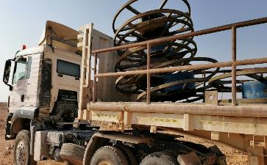
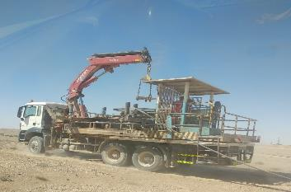
PDO Second Alert
Date:14.10.2020 Incident title: LTI#27, Head Injury
What happened?
On October 14th, 2020 at 14:00hrs, the DWS HDU-1 crew were laying down water hoses in Thamood. During the last 100m of hoses remaining to being laid down, the crew decided to proceed directly from the trailer. The reels on the trailer were unsecured. The rigger who was standing in between the stack of moving reels at the front left of the trailer, instructed the trailer driver to stop. The sudden harsh braking by the driver after the rigger’s instruction, caused the unsecured rotating reels to come out of their connections and strike the rigger on the right side of his face, resulting in his head injury. The rigger was immediately transported to RIG 38 for first aid and then transferred to the hospital, then onwards to Salalah Sultan hospital for further treatment.
Your learning from this incident..
Always follow the approved procedure.
Always intervene to STOP unsafe acts and conditions.
Always stay away from the line of fire.
Never take shortcuts.
Never stand on a moving vehicle.
Conduct TBT/risk assessment before performing any task.
Use positive reinforcement to communicate HSE as a priority.
NEVER STAND ON MOVING TRAILERS!
Target Audience: Drilling, Logistics, Operation, Engineering & Construction
Notes:
Ensure all dates and titles are input
A short description should be provided without mentioning names of contractors or individuals. You should include, what happened, to who (by job title) and what injuries this resulted in. Nothing more!
Four to five bullet points highlighting the main findings from the investigation. Remember the target audience is the front line staff so this should be written in simple terms in a way that everyone can understand.
The strap line should be the main point you want to get across
The images should be self explanatory, what went wrong (if you create a reconstruction please ensure you do not put people at risk) and below how it should be done.

Slide 2
Management self audit
Date:14.10.2020 Incident title: LTI#27, Head Injury
As a learning from this incident and ensure continual improvement all contract
managers must review their HSE HEMP against the questions asked below
Confirm the following:
Do you ensure that all your activities hazards are identified and properly managed?
Do you ensure the right operating procedures are followed and adhered to?
Do you ensure supervision is visible on the field and intervenes?
Do you ensure that SWA system is well implemented in your operations?
Do you ensure the right communication system is implemented within your crews.
Do you ensure that all learnings are captured and relevant procedures, HEMP, SOPs & JSAs are reviewed and updated?
Do you ensure your crews value HSE over operations?
* If the answer is NO to any of the above questions please ensure you take action to correct this finding.
Notes:
Ensure all dates and titles are input
Make a list of closed questions (only ‘yes’ or ‘no’ as an answer) to ask others if they have the same issues based on the management or HSE-MS failings or shortfalls identified in the investigation.
Imagine you have to audit other companies to see if they could have the same issues.
These questions should start with: Do you ensure…………………?

