Slide 1
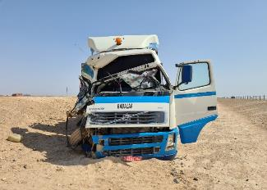
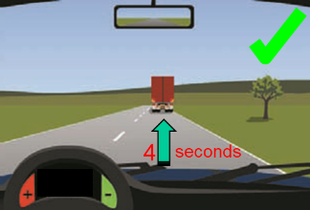
PDO Second Alert
Date: 26.08.2020 Incident Title: HiPo#59
What happened?
A cargo vehicle on route to Izz loaded with 20t of chemical bags was involved in a motor vehicle incident while travelling on a dual carriage way. A water tanker entered the dual carriageway from the hard shoulder into the path of the cargo vehicle. The cargo driver tried to avoid a collision by manoeuvring to the left but the front passenger side of the cab struck the rear driver side of the tanker. This resulted in moderate damage to the tanker and severe damage to the cargo truck prime mover cab. There were no injuries sustained.
Your learning from this incident
Always ensure the road is clear before entering in front of other vehicles.
Always ensure you join roads when you have reached the required speed and it is clear to do so.
Always ensure you adjust your speed when faced with a hazard.
Always ensure you apply defensive driving techniques and read the road ahead.
Always ensure you are cautious of other 3rd party road users.
Always ensure you remain aware of the signs of highway hypnosis.
Always ensure you utilise your music to prevent boredom.
Leave space be safe
Target Audience: Drilling, Logistics & construction

Slide 2
Management self audit
Date: 26.08.2020 Incident title: HiPo#59
As a learning from this incident and ensure continual improvement all contract
managers must review their HSE HEMP against the questions asked below
Confirm the following:
Do you ensure hazards presented by 3rd party vehicles are communicated to drivers on a regular basis?
Do you ensure worksites are planned to allow safe access and egress?
Do you ensure there is adequate signage to warn of hazards?
Do you ensure drivers are aware of the signs of highway hypnosis?
Do you ensure highway hypnosis is captured in your HEMP?
Do you ensure drivers follow defensive driver techniques?
* If the answer is NO to any of the above questions please ensure you take action to correct this finding.
Notes:
Ensure all dates and titles are input
Make a list of closed questions (only ‘yes’ or ‘no’ as an answer) to ask others if they have the same issues based on the management or HSE-MS failings or shortfalls identified in the investigation.
Imagine you have to audit other companies to see if they could have the same issues.
These questions should start with: Do you ensure…………………?

