Slide 1
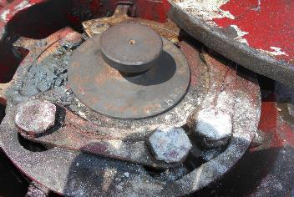
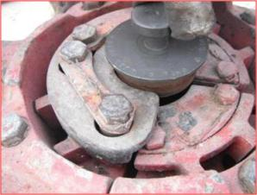
PDO Second Alert
Date: 29.09.2020 Incident title: HIPO#63
What happened?
RIH 4 1/2'' RTTS on 2 7/8" HT PAC Drill Pipes from pipe racks was in progress. The 13th joint was hanging from the 2 7/8” slip type B&V Elevator in order to make-up with power tong. There was an issue observed with power tong that required fixing and it was decided to keep the drill pipe out of the floor next to the V door hanging. At that moment the drill pipe suddenly slipped thru the elevator and fell down to the ground.
Your learning from this incident..
Always check the elevator C plate and HT Pac pipe tool joint OD prior to every tripping and maintain the records in the Elevator check list (ensure the SOP for handling of HT Pac Pipes is always followed with stress to checking prior the tripping).
Always ensure the C plate is inspected for acceptance at every Elevator Inspection interval.
Always comply to the Drops zone management, utilize step back safety zone whenever possible.
Use a No Go gauge to verify condition of Slip type Elevators prior to every use
Target Audience: Drilling, Logistics, Operation & construction
Notes:
Ensure all dates and titles are input
A short description should be provided without mentioning names of contractors or individuals. You should include, what happened, to who (by job title) and what injuries this resulted in. Nothing more!
Four to five bullet points highlighting the main findings from the investigation. Remember the target audience is the front line staff so this should be written in simple terms in a way that everyone can understand.
The strap line should be the main point you want to get across
The images should be self explanatory, what went wrong (if you create a reconstruction please ensure you do not put people at risk) and below how it should be done.

Slide 2
Management self audit
Date: 29.09.2020 Incident title: HIPO#63
As a learning from this incident and ensure continual improvement all contract
managers must review their HSE HEMP against the questions asked below
Confirm the following:
Do you ensure Third party certifications are verified for OEM recommendations?
Do you ensure your Site supervisors check & verify Elevators condition prior any use?
Do you ensure the quality of your Maintenance and Inspection processes meet Company and OEM standards ?
Do you ensure your internal audits are efficient enough to result with improvements to standards?
Do you ensure full compliance to DROPs standards?
Do you ensure focus are done on quality of periodical inspection and maintenance of the equipment in accordance with OEM recommendations?
* If the answer is NO to any of the above questions please ensure you take action to correct this finding.
Notes:
Ensure all dates and titles are input
Make a list of closed questions (only ‘yes’ or ‘no’ as an answer) to ask others if they have the same issues based on the management or HSE-MS failings or shortfalls identified in the investigation.
Imagine you have to audit other companies to see if they could have the same issues.
These questions should start with: Do you ensure…………………?

