Slide 1
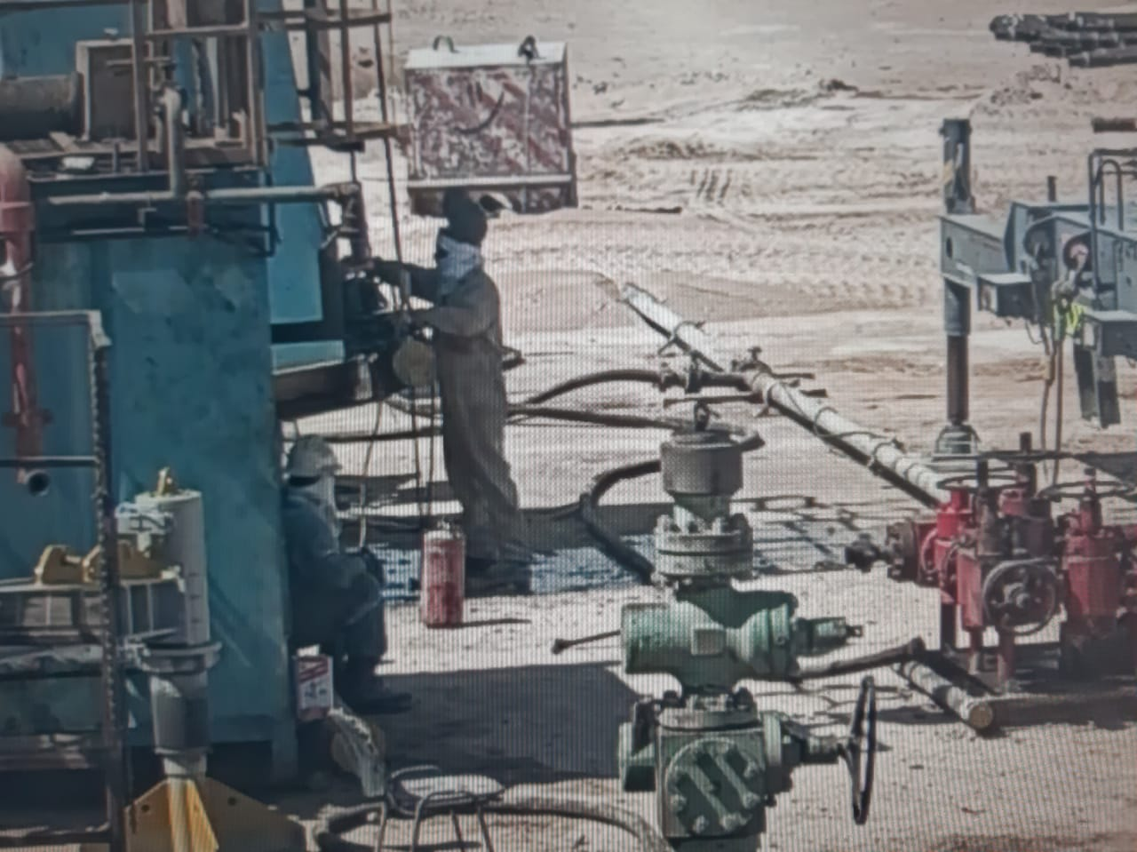
PDO Second Alert
Date: 26.10.2020 Incident Title: Hipo #68
What happened?
On the 26th October 2020 at 09:00 a small leak at the base of the reserve tank was discovered by the crew that was causing a small flow of water with oil mix out onto the sand below. It was decided to have the welder to make a temporary repair on the tank. To stop the small flow of fluid the welder requested assistance and the crane was brought in to lift the tank up on one end so the welding could be completed. With the tank raised up on one end by the crane the welder started to weld a square of metal onto the tank repairing the tank. The job was intervened by HSV to validate the control measures.
Your learning from this incident.
Always follow your PTW process, assign a supervisor/permit holder
Always when the work plan changes, inform your supervisor
Always intervene and stop unsafe acts
Always utilize “10 Questions for a Safe Lift”
Always review your SOPs for routine and non-routine jobs
Always keep good records of your PTW forms
Follow your Permit to Work process completely!
Target Audience: Drilling
Notes:
Ensure all dates and titles are input
A short description should be provided without mentioning names of contractors or individuals. You should include, what happened, to who (by job title) and what injuries this resulted in. Nothing more!
Four to five bullet points highlighting the main findings from the investigation. Remember the target audience is the front line staff so this should be written in simple terms in a way that everyone can understand.
The strap line should be the main point you want to get across
The images should be self explanatory, what went wrong (if you create a reconstruction please ensure you do not put people at risk) and below how it should be done.

Slide 2
Management self audit
Date: 26.10.2020 Incident Title: Hipo #68
As a learning from this incident and ensure continual improvement all contract
managers must review their HSE HEMP against the questions asked below
Confirm the following:
Do you validate your management of PTW systems and PTW records?
Do you have a strong culture for Intervene and Stop unsafe work?
Are your lift planning practices and procedures up to date?
Are your SOPs current and up to date and reflect lateral learning?
Do you validate competency of welders and lifting supervisors?
Do your site teams correctly plan for the job and discuss any changes and dynamics?
Does your PMS include checks for corrosion on non-pressurised tanks and vessels?
* If the answer is NO to any of the above questions please ensure you take action to correct this finding.
Notes:
Ensure all dates and titles are input
Make a list of closed questions (only ‘yes’ or ‘no’ as an answer) to ask others if they have the same issues based on the management or HSE-MS failings or shortfalls identified in the investigation.
Imagine you have to audit other companies to see if they could have the same issues.
These questions should start with: Do you ensure…………………?

