Slide 1
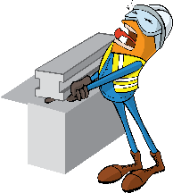
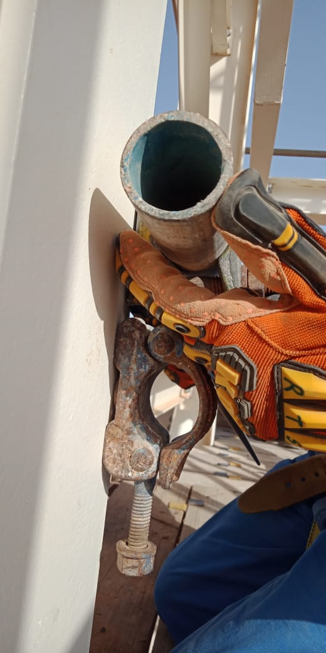
PDO Incident First Alert
Incident Type | LTI#10 | Pattern | Hands and Fingers
Date / Time | 17.05.2021@16:15hrs | Directorate
Location | Nimr production Station- Nimr | Dept
Target Audience
Drilling, Operations, Logistic, Engineering & Construction
What happened
While the Scaffolder was removing middle hand rail beam clamp, the top rail beam clamp moved from its position and landed on his left hand resulting in fracture to his ring finger
Mr. Musleh asks the questions of can it happen to you?
Do you ensure you keep your hands and fingers away from pinch points?
Do you ensure you identify all hazards before starting a task?
Do you discuss Hands & fingers Hazards and controls in your TBT?
Please disseminate this LTI notification to your teams and use it in your tool box talks and HSE meetings and notice boards.
“This document is restricted and it is distributed for information purposes only and it shall not be shared with other than PDO employees and contracts without PDO permission”.

