Slide 1
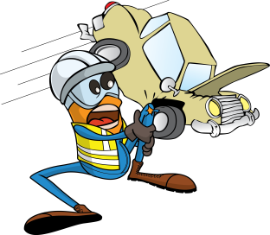
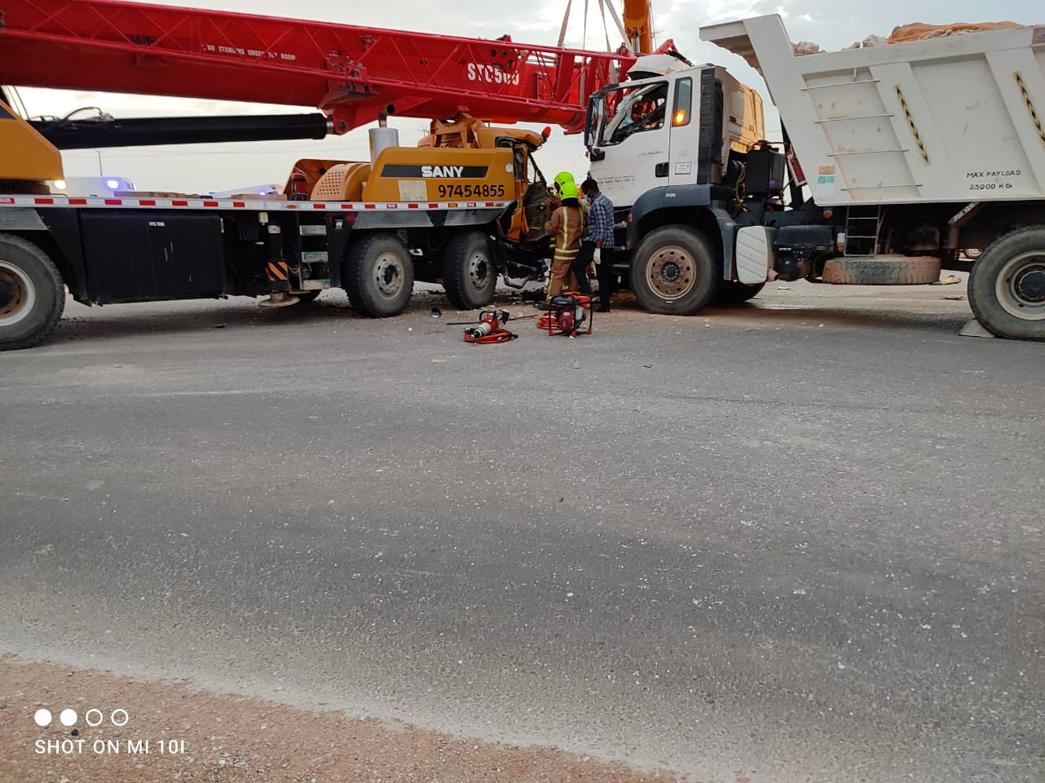
PDO Incident First Alert
Incident Type | LTI#17 | Pattern | MVI
Date / Time | 14.07.2021@17:50hrs | Directorate
Location | Marmul PDO T-Junction | Dept
Target Audience
Drilling, Operations, Engineering & Construction
What happened
While ATE crane was negotiating a left turn at the T-Junction it came in contact with a third party Tipper which was coming from opposite direction. The Rigger who was a passenger in the crane sustained fracture to his right leg.
Mr. Musleh asks the questions of can it happen to you?
Do you always apply defensive driving techniques?
How you can avoid collision with the coming traffic while taking a turn?
Do you pay attention to road hazards and drive accordingly?
Do you intervene with the driver when you feel unsafe?
Please disseminate this LTI notification to your teams and use it in your tool box talks and HSE meetings and notice boards.

