Slide 1
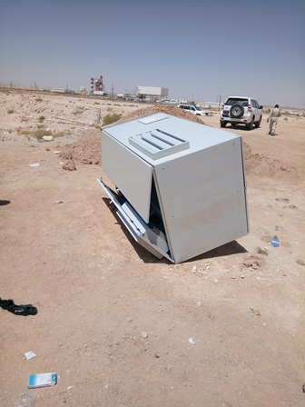
PDO Incident First Alert
Incident Type | LTI#21 | Pattern | Drops
Date / Time | 22.09.2021@10:20hrs | Directorate
Location | Well Site, MM-576, Marmul | Dept
Target Audience
Drilling, Operations, Engineering & Construction
What happened
Whilst offloading Variable Frequency Drive (VFD) panel from the canter, the Electrician was hammering to remove the wooden base attached to the panel where the panel became unbalanced and fell fracturing his right leg.
Mr. Musleh asks the questions of can it happen to you?
Do you ensure you are in a safe position before starting the task?
How do you ensure you identify all hazards in your surroundings?
Do you ensure to follow the correct offloading procedure?
Please disseminate this LTI notification to your teams and use it in your tool box talks and HSE meetings and notice boards.

