Slide 1
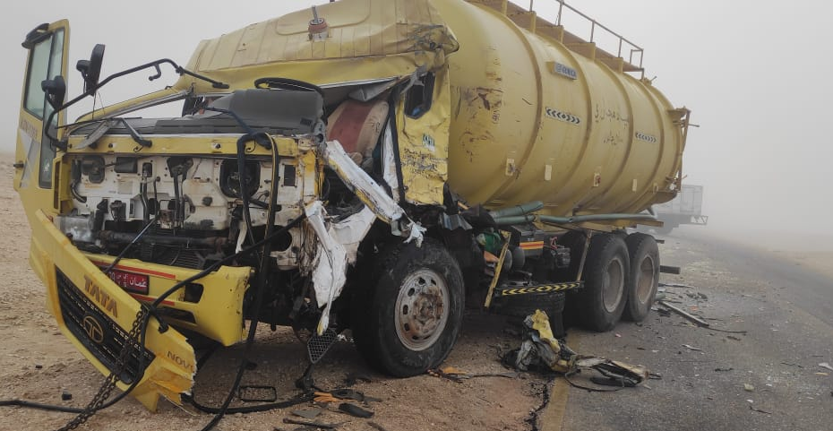
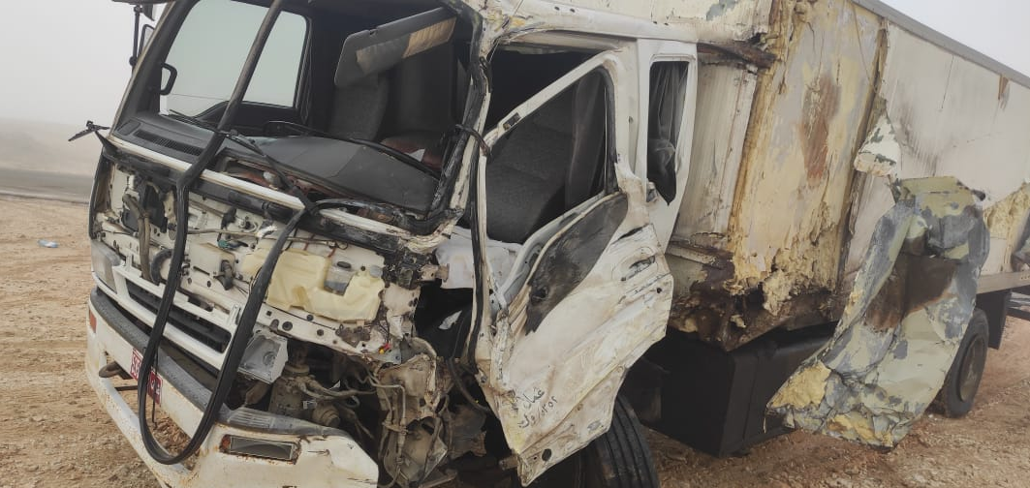
PDO Incident First Alert
Incident Type | LTI#32 | Pattern | MVI
Date / Time | 25.11.2021@04:00hrs | Directorate
Location | Jalmood North field black top, Bahja | Dept
Target Audience
Drilling, Operations, Engineering & Construction
What happened
While the Sewage Tanker Driver was driving from Rima towards Al Ghubrah North , he had a head on collision with a third-party vehicle coming from the opposite road resulting in laceration at his left knee joint.
Mr. Musleh asks the questions of can it happen to you?
Do you ensure you identify and report all road related hazards?
Do you ensure you avoid night driving?
Do you always ensure to apply defensive driving techniques?
Do you ensure you drive according to the road conditions?
Please disseminate this LTI notification to your teams and use it in your tool box talks and HSE meetings and notice boards.

