Slide 1
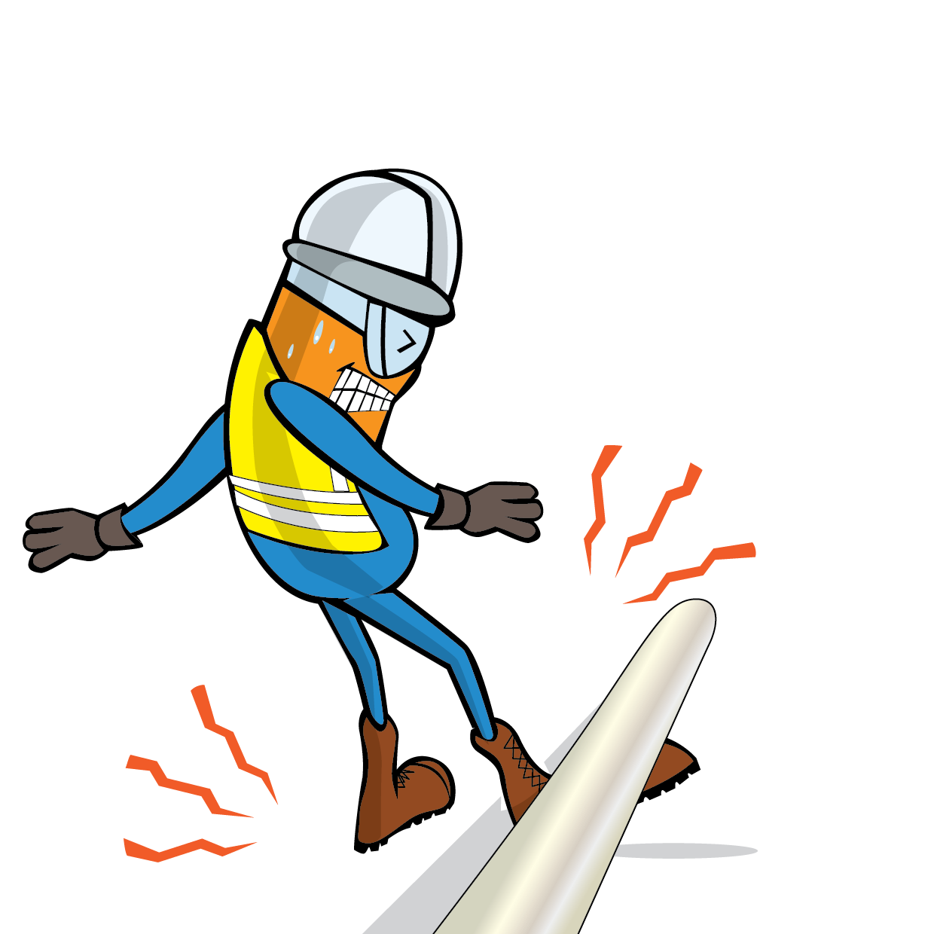
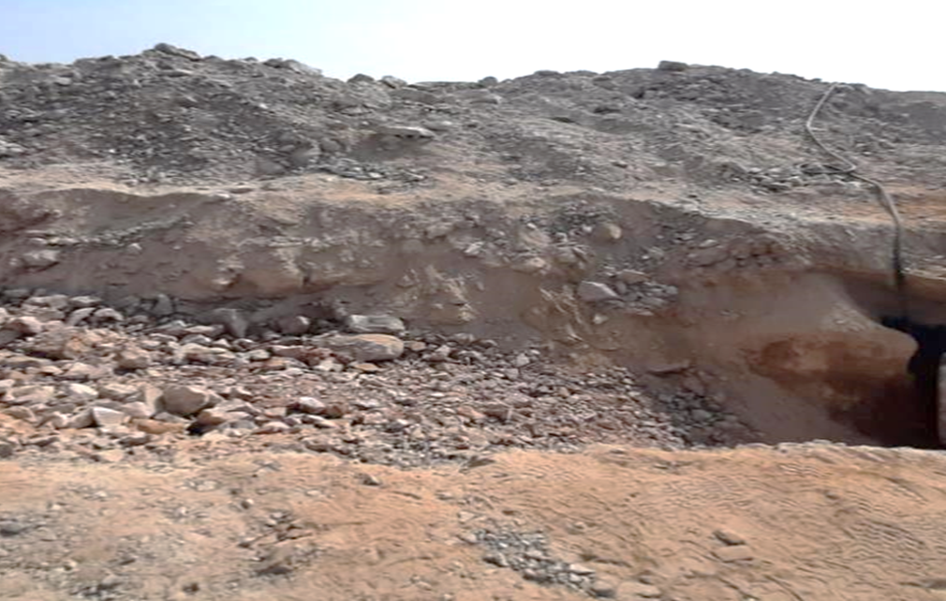
PDO Incident First Alert
Incident Type | LTI#33 | Pattern | Released Energy
Date / Time | 30.11.2021@14:55hrs | Directorate
Location | Construction site , Qarn Alam | Dept
Target Audience
Drilling, Operations, Engineering & Construction
What happened
While the Jack Hammer Operator was engaged in a trench excavation activity, a stone embedded in the excavation slope dislodged, rolled down and hit the Operator leg causing fracture to his left leg
Stone position
Mr. Musleh asks the questions of can it happen to you?
Do you ensure you are stood in a safe place away from line of fire?
Do you comply with PTW requirement?
Do you carry out risk assessment before starting the task?
Do you ensure proper supervision in place during the task?
Rolled and hit operator leg
Please disseminate this LTI notification to your teams and use it in your tool box talks and HSE meetings and notice boards.

