Slide 1
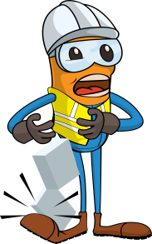
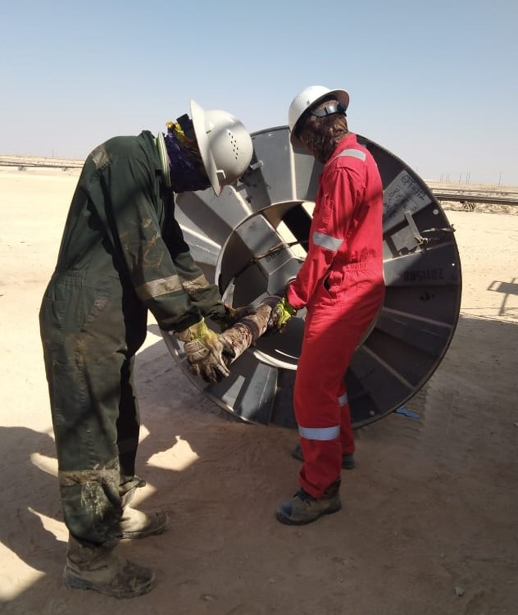
PDO Incident First Alert
Incident Type | LTI#34 | Pattern | Drops
Date / Time | 30.11.2021@06:15hrs | Directorate
Location | WPH-73, Marmul | Dept
Target Audience
Drilling, Operations, Engineering & Construction
What happened
While the Roustabout was assisting the ESP (Electronic Submersible Pump) Technician in pulling the shaft from cable spooler, the shaft got detached from the reel and fell on his right foot causing fracture.
Mr. Musleh asks the questions of can it happen to you?
Do you ensure you identify all hazards before starting a task?
Do you always use the correct lifting procedure?
Do you ensure you keep yourself away from line of fire?
Do you ensure proper supervision to perform the task?
Please disseminate this LTI notification to your teams and use it in your tool box talks and HSE meetings and notice boards.

