Slide 1
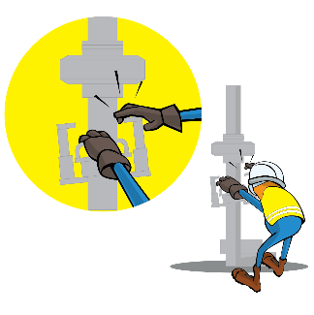
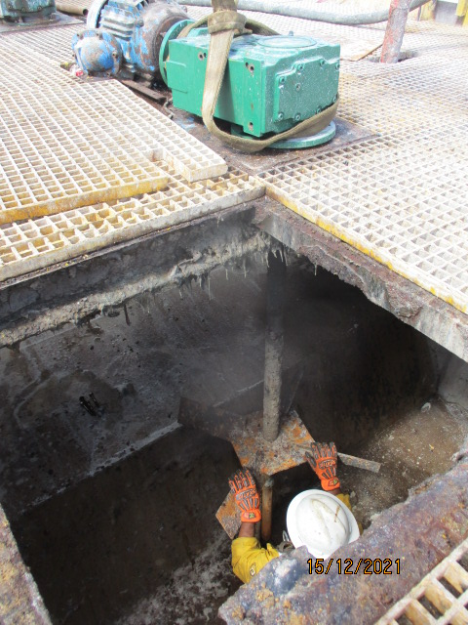
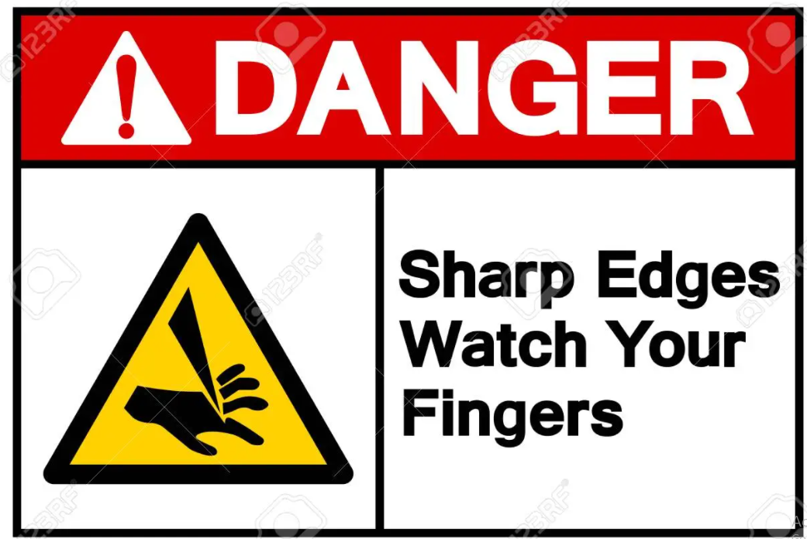
PDO Incident First Alert
Incident Type | LTI#36 | Pattern | Hands and Fingers
Date / Time | 15.12.2021@09:13hrs | Directorate
Location | RIG-81, Marmul | Dept
Target Audience
Logistics, Drilling, Operations, Engineering & Construction
What happened
While the Assistant Mechanic was engaged in fixing the new mud agitator of suction tank. The Assistant Mechanic had his hands on the propeller blades in order to adjust the drive, the drive and shaft made a sudden movement and the blade cut the Assistant Mechanic in his left inner palm causing injury.
Mr. Musleh asks the questions of can it happen to you?
Do you ensure you keep your hands and fingers away from pinch points?
Do you ensure you identify all hazards before starting a task?
Do you always consider if you are in the ‘line of fire’?
Do you ensure proper communication during the task ?
Please disseminate this LTI notification to your teams and use it in your tool box talks and HSE meetings and notice boards.

