Slide 1
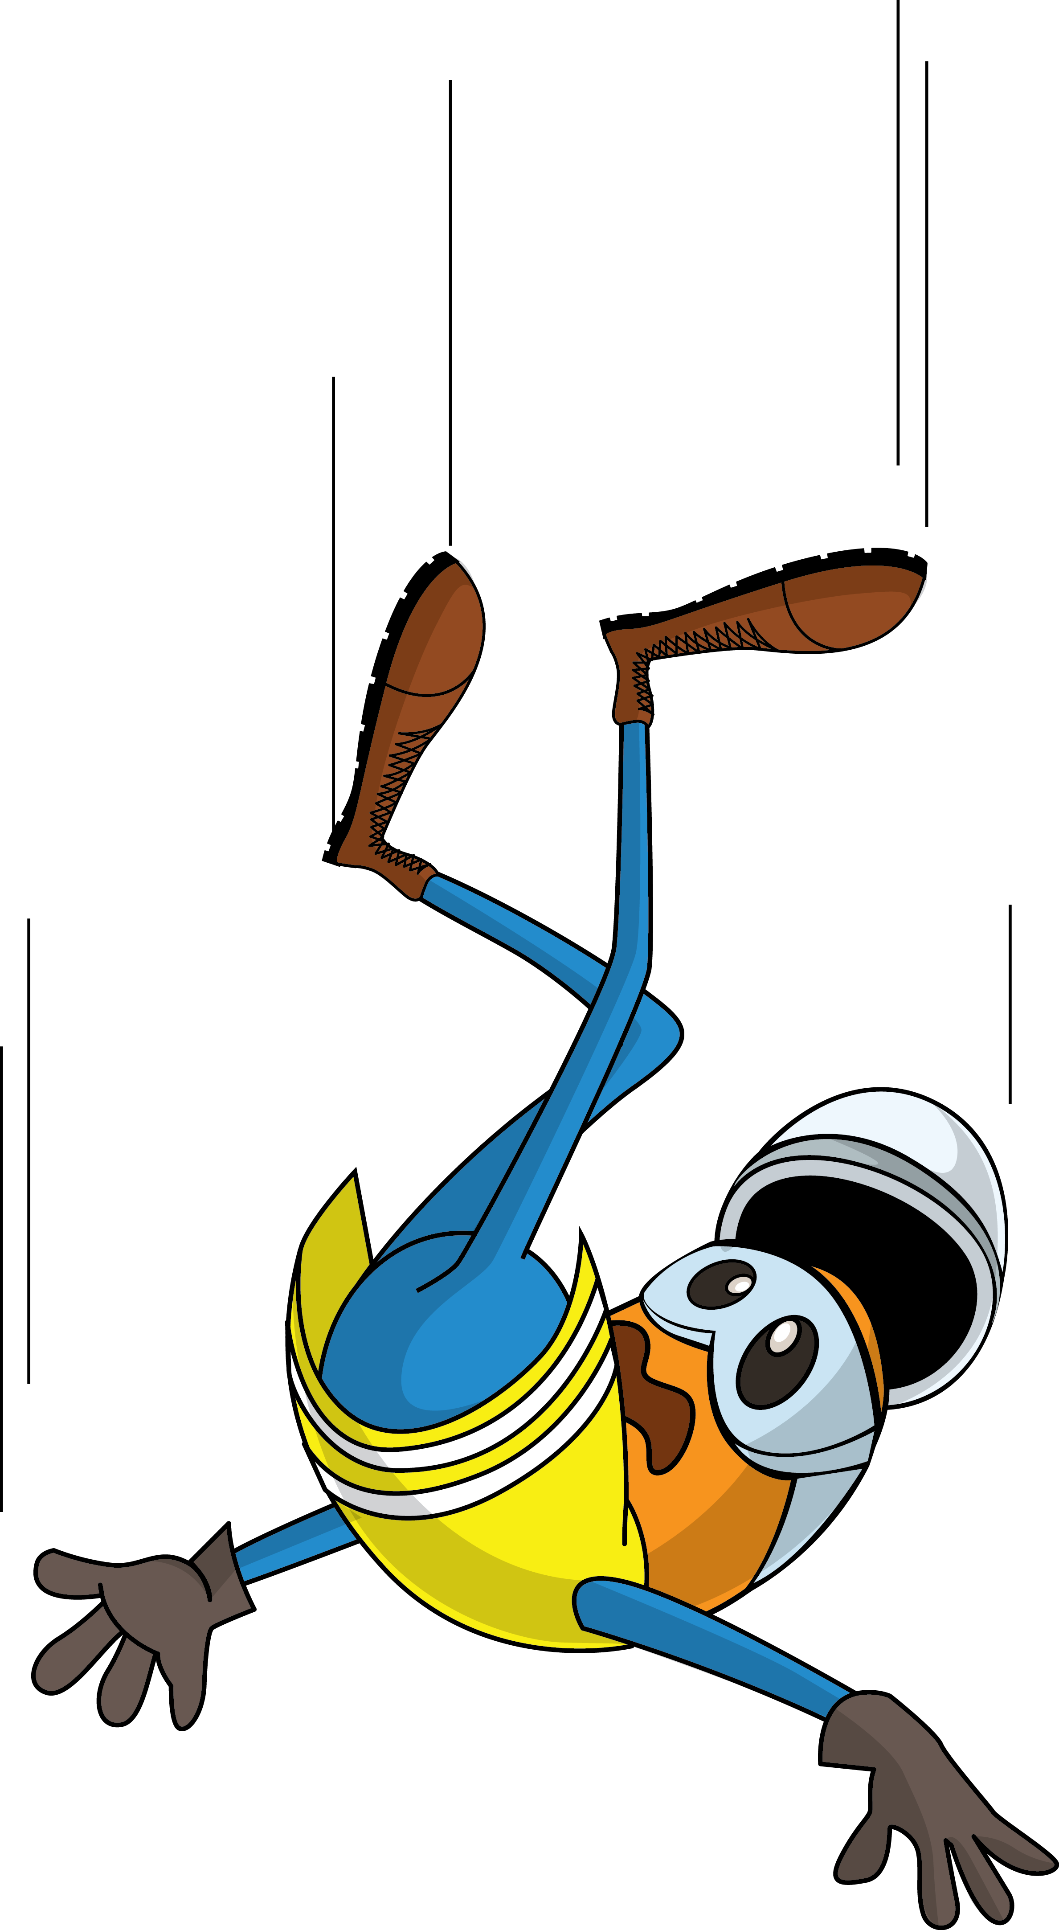
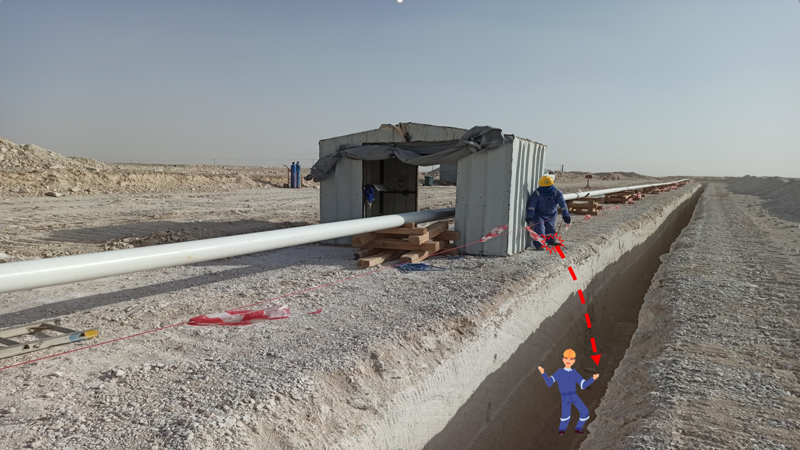
PDO Incident First Alert - L&T
Incident Type | LTI#01 | Pattern | Slip, trip & fall
Date / Time | 04.01.2022@09:32hrs | Directorate | DP
Location | Mabrouk Northeast Development Project, Qarn Alam | Dept | DBM
Target Audience
Drilling, Operations, Engineering & Construction
What happened
During fit up activity of a new flow line and while the Fitter was attempting to cross between the barricaded trench and the welding booth to reach the other side of the booth, his leg tripped over a rubber line, lost balance and fell into the trench causing fracture to his left leg foot Ankle.
Mr. Musleh asks the questions of can it happen to you?
Do you ensure you identify all hazards in your surroundings?
Do always pay attention to where you are stepping?
Do you ensure you use safe access and egress?
Please disseminate this LTI notification to your teams and use it in your tool box talks and HSE meetings and notice boards.

