Slide 1
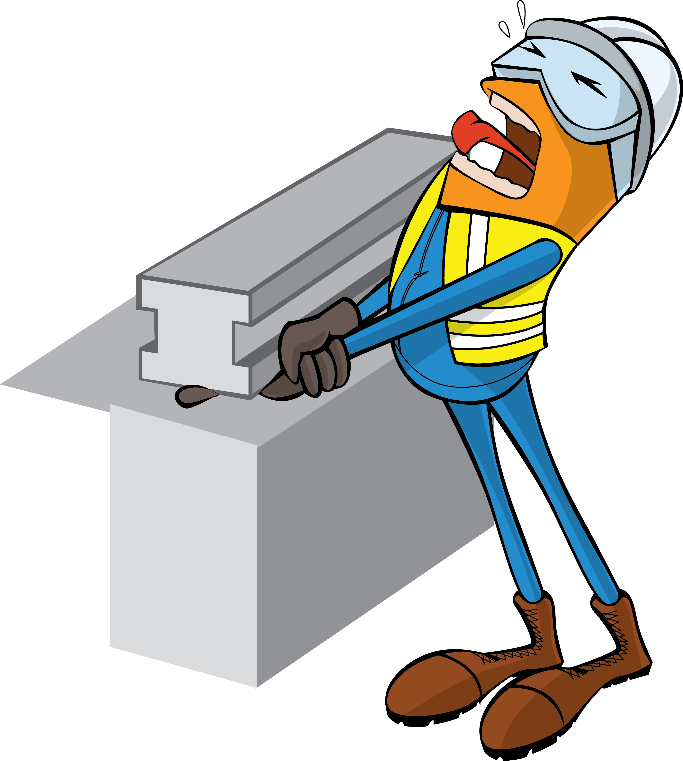
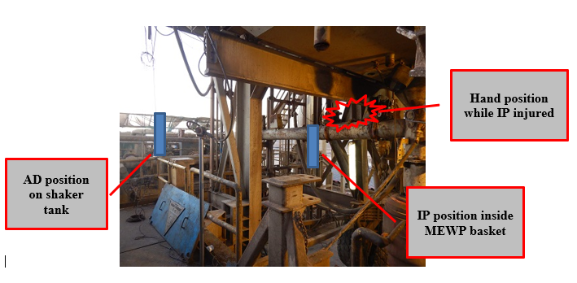
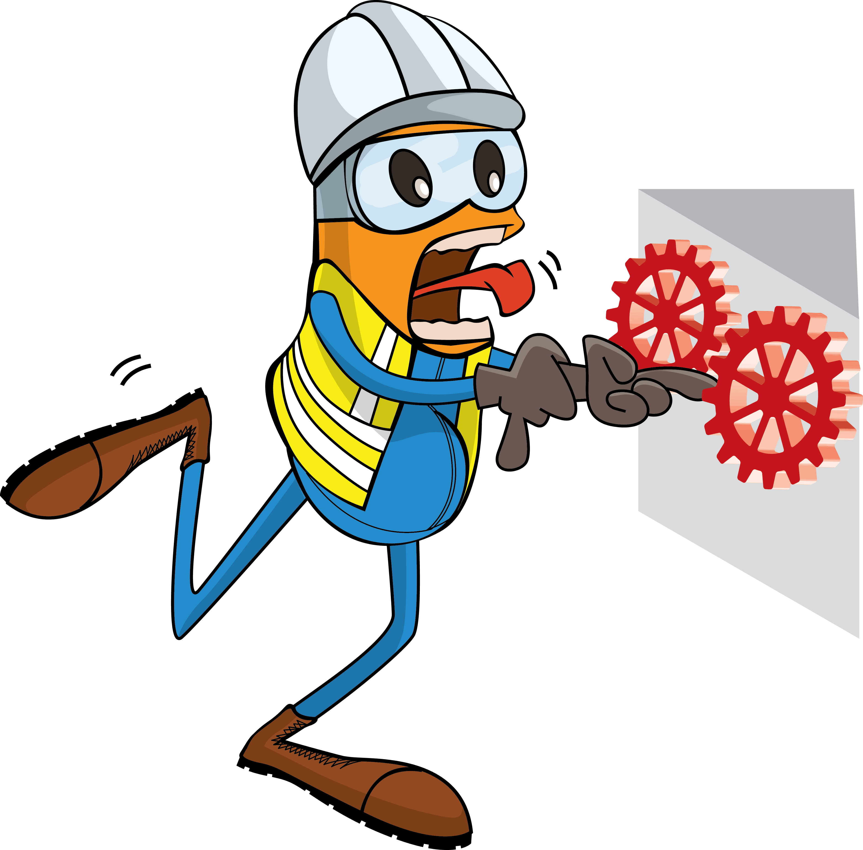
PDO Incident First Alert
Incident Type | LTI#03 | Pattern | Hands and Fingers
Date / Time | 11.01.2022@00:02hrs | Directorate
Location | Qarat Al Milh Small Fields (QSF), Qarn Alam | Dept
Target Audience
Drilling, Operations, Engineering & Construction
What happened
While the Floorman was assisting in winching the flow line, the winch operator mistakenly lifted the winch line up and the Floorman hand got stuck between flow line and BOP beam pinching his right thumb finger.
Mr. Musleh asks the questions of can it happen to you?
Do you ensure you keep your hands and fingers away from pinch points?
Do you ensure you identify all hazards before starting a task?
Do you consider “what could go wrong?”
Please disseminate this LTI notification to your teams and use it in your tool box talks and HSE meetings and notice boards.

