Slide 1
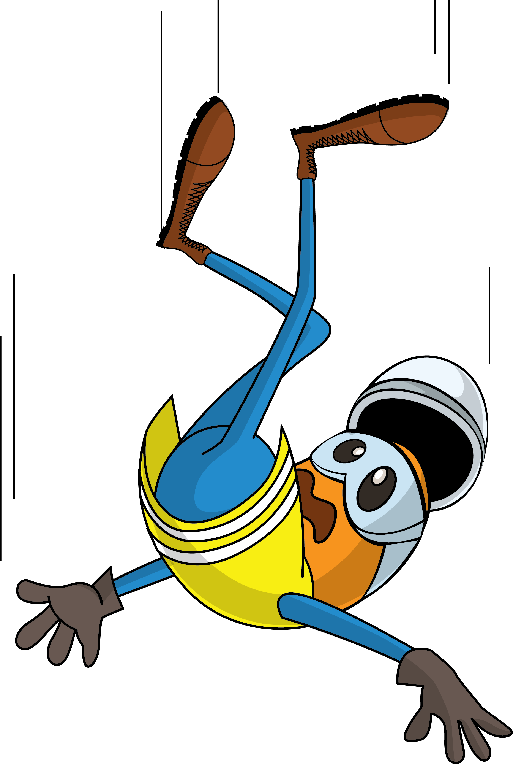
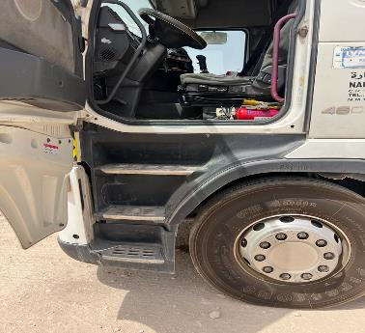
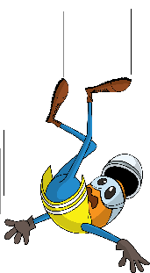
PDO Incident First Alert
Incident Type | LTI#21 | Pattern | Slip & fall | In case of an emergency please call PDO Emergency Number (Toll Free): 2467-5555
Date / Time | 09.06.2022@15:15hrs | Directorate | UID
Location | PDO logistics yard, Nimr | Dept | UIL
Target Audience: Well Engineering, Infrastructure, Operations, Engineering, Project Delivery & External Affairs
What happened
While the Driver was descending from his truck, he lost balance and fell to the ground from the cab resulting in an injury to his lower back.
Mr. Musleh asks the questions of can it happen to you?
Do always pay attention to where you are stepping?
Do you always consider what If you may fall from height?
Do you ensure to use three points of contact while ascending /descending vehicle stairs?
Please disseminate this LTI notification to your teams and use it in your tool box talks and HSE meetings and notice boards.

