Slide 1
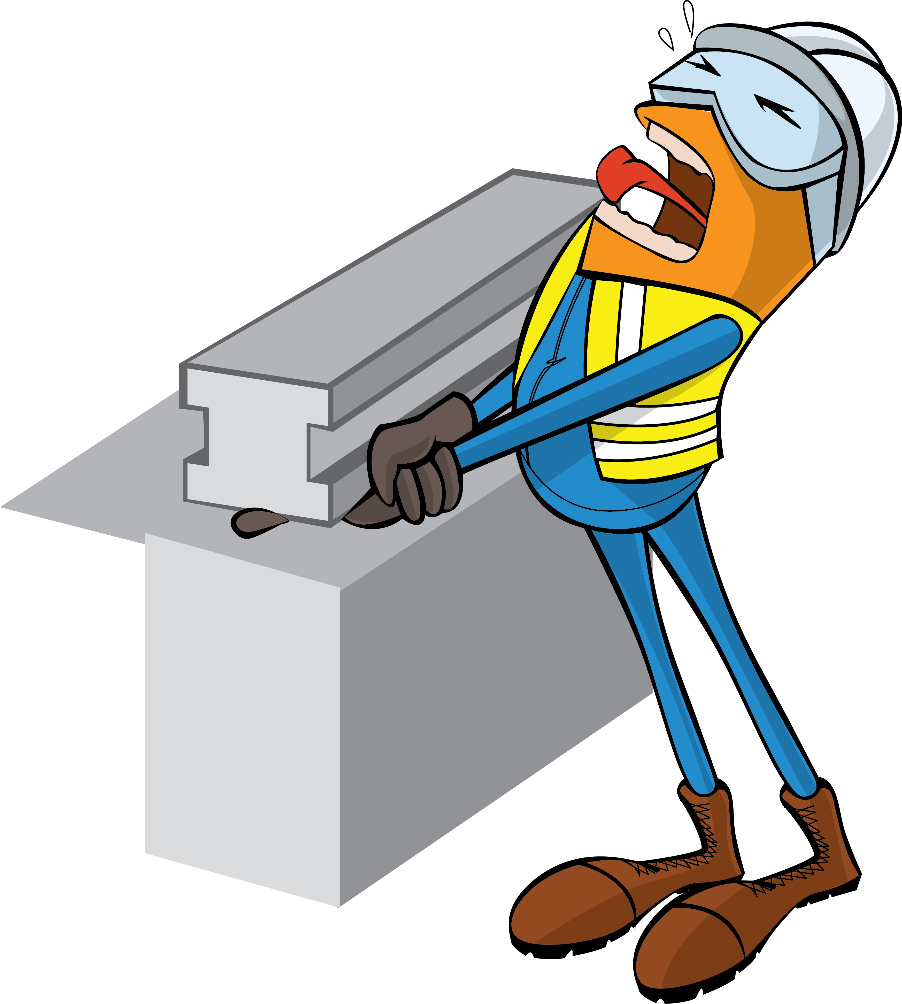
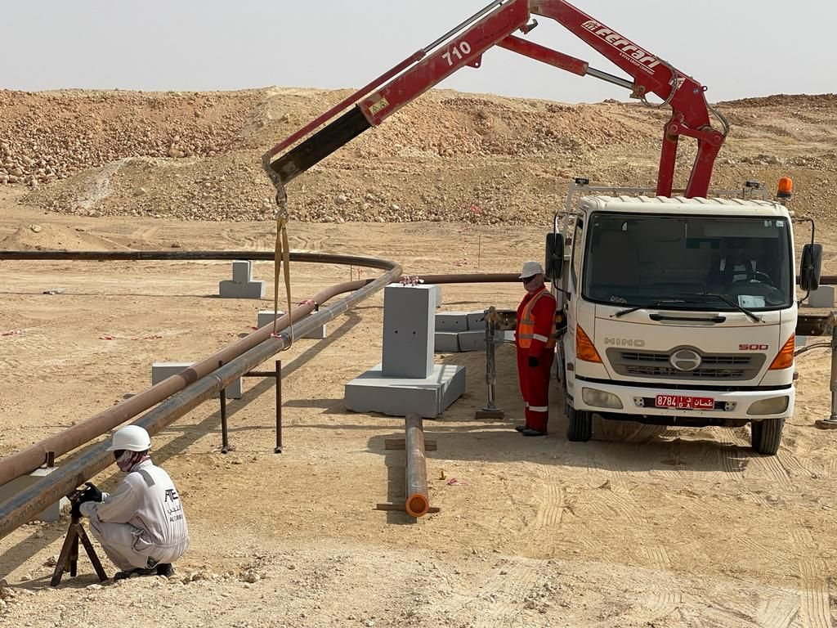
PDO Incident First Alert
Incident Type | LTI#25 | Pattern | Hands & Fingers | In case of an emergency please call PDO Emergency Number (Toll Free): 2467-5555
Date / Time | 29.06.2022@16:15 hrs | Directorate
Location | Nimr -Saqr Field | Dept
Target Audience: Well Engineering, Infrastructure, Operations, Engineering, Project Delivery & External Affairs
What happened
While Mechanical Permit Holder was removing the tripod support under the 6” pipe, the pipe inadvertently moved down and hit the tripod, his hand trapped in between the tripod and pipe resulting in crush injury to his right thumb finger.
Mr. Musleh asks the questions of can it happen to you?
Do you always ensure to place your body parts away from “line of fire”?
Do you ensure adequate Supervision during task?
Do you Stop or intervene if you notice unsafe act/unsafe condition?
Do you ensure controls in place to manage out of sight location?
Do you ensure to assign right crew for the task?
Please disseminate this LTI notification to your teams and use it in your tool box talks and HSE meetings and notice boards.

