Slide 1
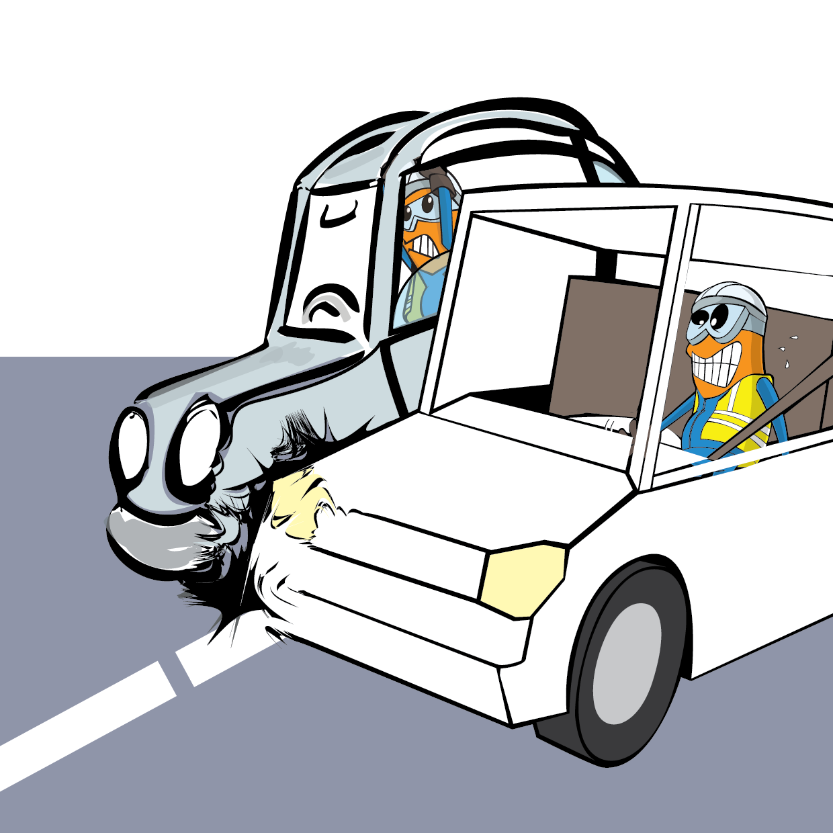
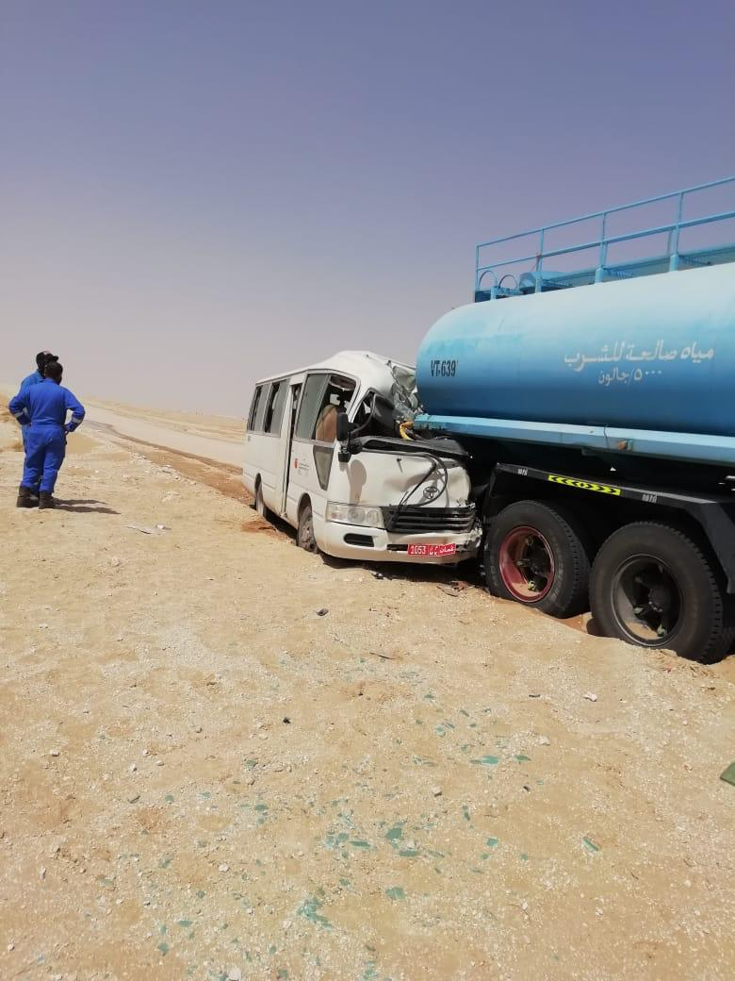
PDO Incident First Alert
Incident Type | LTI#18 &19 | Pattern | MVI | In case of an emergency please call PDO Emergency Number (Toll Free): 2467-5555
Date / Time | 15.05.2022@ 09:30 hrs | Directorate
Location | Al Ghubar to Raba road, Qarn Alam | Dept
Target Audience: Well Engineering, Infrastructure, Operations, Engineering, Project Delivery & External Affairs
What happened
While the Forklift Operator was driving a crew bus , with total of six passengers , travelling from Al Ghubar to Raba , the bus collided with a water tanker stationed on the side of the road , resulted in a fracture to the Derrickman arm and dislocation to the Driller left leg.
Mr. Musleh asks the questions of can it happen to you?
Do you ensure you identify all road hazards and drive accordingly?
Do you always apply defensive driving techniques?
Do you ensure you drive according to the road conditions?
Do you park the vehicles outside the road during an emergency and put warning signs?
Do you focus on the road and avoid distraction?
Please disseminate this LTI notification to your teams and use it in your tool box talks and HSE meetings and notice boards.

