Slide 1
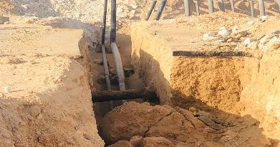
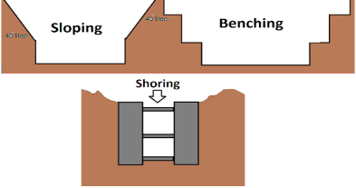
Learning From Incident Awareness Alert
Alert NO: PIM# | PDO LFI_1309202200 Fatality#04 1143812 | Pattern: | Trench & Excavation
Date: | 03/09/2022 | Target Audience: | Construction, Drilling, Operations, Exploration and Logistic
Trench collapsed- Investigation in progress
Description of the incident:
On September 3rd, 2022, at approximately 15:40 hrs, after lowering the flowline in the road crossing trench which was excavated Near Fahud D station black top, prior to the holiday test activity the jackhammer operator together with 3 other civil helpers went inside the trench to clean the trench from few small stones. The 3 civil helpers exit the trench, the operator continued cleaning, the trench wall collapsed trapping the operator with the collapsed lump of soil. The operator was freed by the crew members, emergency number was initiand and transferred to PDO clinic. He was later transferred to Nizwa for further treatment, but unfortunately on the way to Nizwa, the operator condition deteriorated and resulted in an unfortunate death.
Why it happened/Finding :
Poor emergency preparedness and implementation
No shoring in place and no dynamic risk assessment done
Poor planning for the task and poor Risk assessment controls implementation
Lack of single focal point to manage and control interface activities.
Lack of supervisor and assurance by the site management
Poor PTW implementation and poor quality of TBT
No cave-in protection
Photo explaining how it should be done right
Notes:
Target audience for this alert
List the position names or roles that are the target audience for this alert. Wherever possible, the target audience should be limited to those in positions or roles or locations for which the lesson learnt are relevant, or who are required to take action upon receiving this Alert.
Position or role name
Position or role name
Description of the incident:
This should be free text writing and include the relevant facts explaining. what happened to all the relevant parties in a short sharp factual paragraph that describes the incident.
Without mentioning names of contractors or individuals. You should include, what happened, to who (by job title) and what injuries this resulted in. Nothing more
The description should be in sufficient detail to allow a person who does not know anything about the incident to imagine it.
It should only be about what happened and not why it happened.
DO NOT include investigation findings here, simply describe the incident as the investigation has shown it happened.
DO NOT give us a sequence of events here.

Slide 2
Learning From Incident Awareness Alert
Lessons learned:
Ensure emergency response is followed as per procedure
Ensure to carryout dynamic risk assessments when new hazards appeared
Ensure Learning from incidents are effectively implemented to avoid similar incident
Ensure single focal point to manage the interface and adequate supervision
Ensure not to accept jobs and task that will compromise HSE controls due to time constraints
Ensure compliance with SP requirements and risk assessments
Management Confirm the following:
Do you ensure emergency response procedure is followed?
Do you ensure that dynamic risks are conducted, understood and implemented by the site team?
Do you ensure that you have assigned a single focal point to take control of interface jobs and tasks?
Do you ensure trenching and excavation activities are controlled and potential risks are mitigated?
Do you ensure you comply with the SP (shoring) requirements set?
Do you ensure you comply with the risk assessments for the tasks?
Do you ensure PTW controls implemented at site?
* If the answer is NO to any of the above questions please ensure you take action to correct this finding.
**As a learning from this incident and ensure continual improvement review risk management ( HEMP) against the questions
As a learning from this incident and ensure continual improvement all contract managers must review their HSE risk management against the questions asked below
Notes:
Why it happened
Describe here the:
Immediate causes of the incident; and
Underlying causes of the incident
Lessons Learned: Four to five bullet points highlighting the main findings from the investigation. Remember the target audience is the front line staff so this should be written in simple terms in a way that everyone can understand.
Contract managers: Must review their risk assessment for this task capturing all points raised as a minimum and provide assurance to Contract Holders

