Slide 1
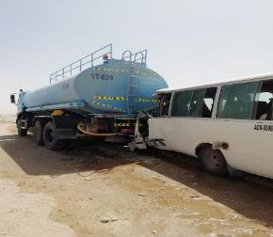
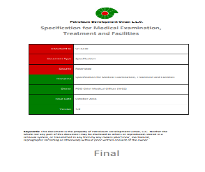
PDO Second Alert
Date:15/05/2022 Incident title: Fatality #1 (LTI # 17, 18 & 19) Pattern: MVI Potential severity: C5P
Target Audience: Drilling, Logistics, Operation & Construction
What happened?
On 15th May 2022 @ 09:22 hrs. while WPH70 was moving from Al-Ghubar to Raba area in Qarn Alam field, on graded road, a crew
bus with 1 driver and 5 passengers collided with a stationary water tanker which was stopped on the right side of the road.
This resulted in the driver’s fatality. Three passengers were injured, two passengers unharmed. All passengers were sent to the
PDO Qarn Alam clinic for medical consultation. ROP & PDO emergency call center were notified & Emergency Response and Crisis
Management team was Immediately set up.
Why it happened/Finding :
Driver lost control of the bus and collided with the rear of the stopped water tanker.
FTW was not in alignment with SP-1230 requirements (for bus driver)
Tanker was not fully parked off the road.
Driving Techniques (steer away from safe zones and remain in carriageway) were not applied
Position of the vehicle on the road - including non-placement of safety triangle behind the parked water tanker
Your learning from this incident..
Always ensure to raise awareness on Fatigue Management – check implementation and audit on a regular basis
Always ensure that the FTW process strictly adheres to SP – 1230 requirements
Always be vigilant & aware of potential road hazards; Do not be distracted and keep eyes on the road. Always ensure the authorized drivers are following Driving techniques: Drive Defensively and always prepare to anticipate mistakes
Always ensure that you do not park/stop your vehicles on graded road (in case of emergency)
Always ensure all drivers use the safety triangle & flash the hazard lights during emergency stoppage.
Always ensure fatigue and health risks are well managed prior to driving
Notes:
Ensure all dates and titles are input
A short description should be provided without mentioning names of contractors or individuals. You should include, what happened, to who (by job title) and what injuries this resulted in. Nothing more!
Four to five bullet points highlighting the main findings from the investigation. Remember the target audience is the front line staff so this should be written in simple terms in a way that everyone can understand.
The strap line should be the main point you want to get across
The images should be self explanatory, what went wrong (if you create a reconstruction please ensure you do not put people at risk) and below how it should be done.

Slide 2
Management self audit
Date:15/05/2022 Incident title: Fatality #1 (LTI # 17, 18 & 19) Pattern: MVI Potential severity: C5P
As a learning from this incident and ensure continual improvement all contract managers must review their HSE risk management against the questions asked below
Confirm the following:
Do you ensure your drivers are aware of fatigue management system and what to do in case they experience fatigue?
Do you ensure your FTW is done in accordance with SP-1230 for drivers to ensure that there are no health-related issues that are not made aware?
Do you ensure that you check the IVMS is reliable and fully functional before moving the vehicle and do you verify that the Journey Managers are monitoring the IVMS for all journeys?
Do you ensure that your drivers are learning from incidents related to road safety and implementing the remedial actions at all times while driving or stopping on journey?
Do you ensure that drivers park the vehicles outside the road completely during an emergency and put warning signs to alert incoming drivers?
* If the answer is NO to any of the above questions please ensure you take action to correct this finding
Notes:
Ensure all dates and titles are input
Make a list of closed questions (only ‘yes’ or ‘no’ as an answer) to ask others if they have the same issues based on the management or HSE-MS failings or shortfalls identified in the investigation.
Imagine you have to audit other companies to see if they could have the same issues.
These questions should start with: Do you ensure…………………?

