Slide 1
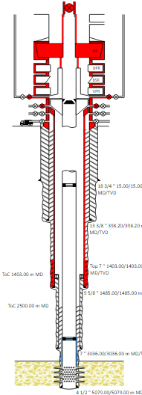
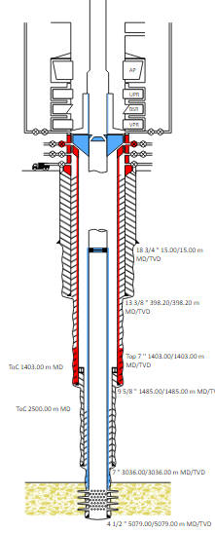
PDO Second Alert
Date: 21.07.2022 Incident title: Fat 2 & 3 Pattern: Released Energy Potential severity: C5P Activity: Hydraulic work over
Target Audience: All
What happened?
During a well operation to restore Well Integrity of a gas production well, the Tubing Hanger ejected up through an open Blow Out Preventer (BOP) together with the a well plug followed by a large release of gas. Above the BOP, two individuals were struck by the combination of ejected equipment combined with the force of gas being released resulting in their loss of life. The well was immediately secured by closing the open BOP and Side Outlet Valves.
Why it happened/Finding :
The plug was set too shallow and assumed to have set correctly due to the fact that it had sealed pressure for a long period of time.
Part of the considered Secondary Barrier envelope (BOP) was open to prepare to remove the Tubing Hanger, hence considering it as part of a Barrier at this point in time was not valid until it is closed.
Your learning from this incident..
All Well Barriers shall be formally qualified
Single Barrier Operations shall be only accepted under an Approved Deviation (Management of Change MOC)
All variations (Management of Change MOC) to a program shall be reported in writing and formally approved.
Having no pressure above a plug (well barrier) alone does not necessarily indicate the barrier is fully verified.
All Well Barriers shall be independent & Identified, Verified & Monitored.
Well Risk shall be captured within the handover from one team to another.
2x Qualified Barriers
Single Barrier
Single Barrier Operations shall be only accepted under an Approved Deviation (Management of Change MOC)
Notes:
Ensure all dates and titles are input
A short description should be provided without mentioning names of contractors or individuals. You should include, what happened, to who (by job title) and what injuries this resulted in. Nothing more!
Four to five bullet points highlighting the main findings from the investigation. Remember the target audience is the front line staff so this should be written in simple terms in a way that everyone can understand.
The strap line should be the main point you want to get across
The images should be self explanatory, what went wrong (if you create a reconstruction please ensure you do not put people at risk) and below how it should be done.

Slide 2
Management self audit
Date: 21.07.2022 Incident title: Fat 2 & 3 Pattern: Released Energy Potential severity: C5P Activity: Hydraulic work over
As a learning from this incident and ensure continual improvement all contract managers must review their HSE risk management against the questions asked below
Confirm the following:
Are Well Barriers visible and understood for every stage and every step of the operation
Are Single Barrier Operations approved by the correct technical authority
Is there clear evidence that the Well Risk is clearly understood by all parties
* If the answer is NO to any of the above questions please ensure you take action to correct this finding
Notes:
Ensure all dates and titles are input
Make a list of closed questions (only ‘yes’ or ‘no’ as an answer) to ask others if they have the same issues based on the management or HSE-MS failings or shortfalls identified in the investigation.
Imagine you have to audit other companies to see if they could have the same issues.
These questions should start with: Do you ensure…………………?

