Slide 1
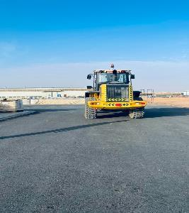
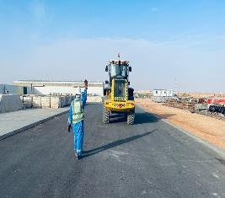
Hipo #8 BE-Truckoman South-Asset Damage-20.02.2023
Date: 20/02/2023 Incident title: HiPo#08 Pattern: Asset Damage Activity: Lifting Potential severity: C4P
Target Audience: Forklift operators, Banksman / Signaler, Supervisors
What happened?
On February 20th, around 14.47hrs an asset damage incident was reported from Nimr Supply Yard that occurred during loading chemical pallets in NIMR Supply Yard. The incident occurred while one of the forklift was reversing and the operator lost the control to the forklift. It collided with some foam chemical drums. Partial damage occurred to chemical drums and a slight scratch was sustained by the forklift. No injuries were sustained.
Why it happened/Finding :
The FLT operator reversed on a long distance instead of making U-turn and move forward.
The lack of adequate supervision during such long-distance reversing.
No intervention by those involved during such a situation when supervision is inadequate.
The positioning of banksman was not accurate as he did not have 360° view during signalling
Your learning from this incident..
Always ensure adequate supervision is available during operation.
Always ensure that the banksman is positioned away from line of fire and should have 360° view before signalling.
Always ensure induction is being given to the crew/visitor working in the yard.
Always ensure your FLT operator is aware of the hazards at site.
Banksman! Always be visible to plant operators
Notes:
Ensure all dates and titles are input
A short description should be provided without mentioning names of contractors or individuals. You should include, what happened, to who (by job title) and what injuries this resulted in. Nothing more!
Four to five bullet points highlighting the main findings from the investigation. Remember the target audience is the front line staff so this should be written in simple terms in a way that everyone can understand.
The strap line should be the main point you want to get across
The images should be self explanatory, what went wrong (if you create a reconstruction please ensure you do not put people at risk) and below how it should be done.

Slide 2
Hipo #8 BE-Truckoman South-Asset Damage-20.02.2023
Date: 20/02/2023 Incident title: HiPo#08 Pattern: Asset Damage Activity: Lifting Potential severity: C4P
As a learning from this incident and ensure continual improvement all contract managers must review their HSE risk management against the questions asked below
Confirm the following:
Do you ensure all activities performed are included in HEMP and SOP ?
Do you ensure you identify all hazards before starting a task?
Do you ensure your crew are aware of their roles and responsibilities prior to commencement of work?
Do you ensure all operation are carried out under appropriate supervision?
Do you ensure the competency of the personnel involved?
Do you ensure specific TBT are being carried out for all work activities?
* If the answer is NO to any of the above questions please ensure you take action to correct this finding
Notes:
Ensure all dates and titles are input
Make a list of closed questions (only ‘yes’ or ‘no’ as an answer) to ask others if they have the same issues based on the management or HSE-MS failings or shortfalls identified in the investigation.
Imagine you have to audit other companies to see if they could have the same issues.
These questions should start with: Do you ensure…………………?

