Slide 1
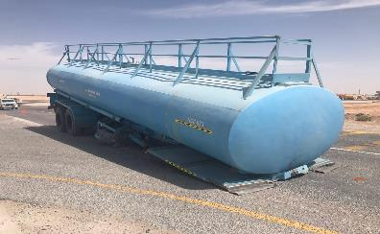
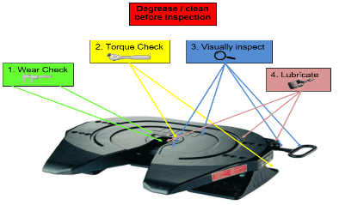
PDO Second Alert
Date: 09/04/2023 Incident title: HiPo#18 Pattern: HiPo Potential severity: B4P Activity: Driving
Target Audience: Drilling, Logistics, Operation & Construction
What happened?
On 09th April 2021 at approx. 0959 hrs. an empty water tanker was detached from a prime mover and dropped to the ground after making a left turn at a T junction near to the Marmul roundabout . The prime mover and water tanker was on its ways to its base thereafter for renewing the expired ROP of water tanker.
Why it happened/Finding :
Inadequate maintenance of fifth wheel
Pull test not completed
Use not assessed in line with failure expectations wear rates
Your learning from this incident..
Always ensure king pin and fifth wheel are inspected and maintained as per OEM recommendation as well as PDO standard.
Always report any defect to the maintenance team.
Always ensure driver is carrying out pull test
Always ensure you carry out quality checks on your maintenance process
Always ensure you have sufficient rest between shifts
Consider adding the 5th wheel lock tool also
Ensure all parts are correct, before you connect
Notes:
Ensure all dates and titles are input
A short description should be provided without mentioning names of contractors or individuals. You should include, what happened, to who (by job title) and what injuries this resulted in. Nothing more!
Four to five bullet points highlighting the main findings from the investigation. Remember the target audience is the front line staff so this should be written in simple terms in a way that everyone can understand.
The strap line should be the main point you want to get across
The images should be self explanatory, what went wrong (if you create a reconstruction please ensure you do not put people at risk) and below how it should be done.

Slide 2
Management self audit
Date: 09/04/2023 Incident title: HiPo#18 Pattern: HiPo Potential severity: B4P Activity: Driving
As a learning from this incident and ensure continual improvement all contract managers must review their HSE risk management against the questions asked below
Confirm the following:
Do you ensure your maintenance team follow OEM recommendation?
Do you ensure assurance checks are being carried out to ensure the maintenance process are followed?
Do you ensure defect reporting procedure is being followed and acted upon?
Do you ensure you have a robust vehicle breakdown recovery plan?
Do you ensure your planning considers employees having adequate rest before starting work?
Do you ensure your maintenance process includes Identification of wear limits?
* If the answer is NO to any of the above questions please ensure you take action to correct this finding
Notes:
Ensure all dates and titles are input
Make a list of closed questions (only ‘yes’ or ‘no’ as an answer) to ask others if they have the same issues based on the management or HSE-MS failings or shortfalls identified in the investigation.
Imagine you have to audit other companies to see if they could have the same issues.
These questions should start with: Do you ensure…………………?

