Slide 1
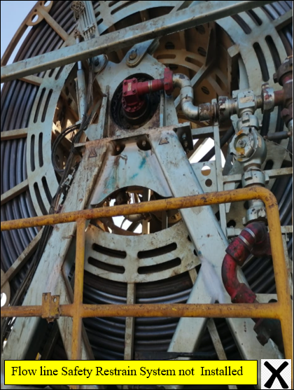
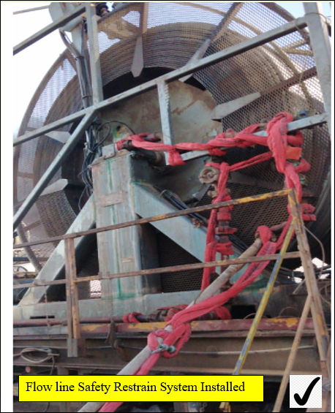
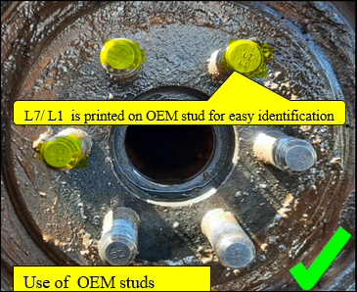
PDO Second Alert
Date: 28.01.2021 Incident title: HiPo#8
What happened?
During CT Scale milling operation and while POOH approximately 4490 m, suddenly the reel swivel assembly disconnected and fell on the ground along with the pumping line (~170 kg) from height of 3 meters. The supervisor immediately took all the necessary precautions, stopped pumping, and secured the well. The area was barricaded and no one from the crew was around. .
SQM immediately headed to the field to evaluate the situation with PDO and decided to POOH and mobilize CT back to base for further investigation and to rectify the defective part.
learning from this incident..
Always use parts that comply with OEM recommendations and specifications.
Always ensure to secure pumping lines to the reel swivel with FSR. (Flow line Safety Restraint System).
Always ensure walk the line & P&ID is conducted prior starting the operation.
Always implement and manage the No Go & Red Zones
Always use OEM recommended Parts!
Notes:
Ensure all dates and titles are input
A short description should be provided without mentioning names of contractors or individuals. You should include, what happened, to who (by job title) and what injuries this resulted in. Nothing more!
Four to five bullet points highlighting the main findings from the investigation. Remember the target audience is the front line staff so this should be written in simple terms in a way that everyone can understand.
The strap line should be the main point you want to get across
The images should be self explanatory, what went wrong (if you create a reconstruction please ensure you do not put people at risk) and below how it should be done.

Slide 2
Management self audit
Date: 28.01.2021 Incident title: HiPo#8
As a learning from this incident and ensure continual improvement all contract
managers must review their HSE HEMP against the questions asked below
Confirm the following:
Do you always ensure effectiveness of the training provided to the operation team ?
Do you always ensure proper implementation of job-related checklists?
Do you always ensure walk the line; P&ID are carried out prior the operation?
Does your management carry out periodic review of the existing SOPs/WIs and Checklists?
Do you always ensure the availability of procedure for changing REEL ?
Do you always ensure the availability of OEM spare parts while doing the maintenance?
Notes:
Ensure all dates and titles are input
Make a list of closed questions (only ‘yes’ or ‘no’ as an answer) to ask others if they have the same issues based on the management or HSE-MS failings or shortfalls identified in the investigation.
Imagine you have to audit other companies to see if they could have the same issues.
These questions should start with: Do you ensure…………………?

