Slide 1
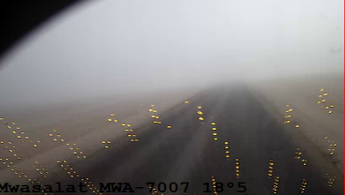
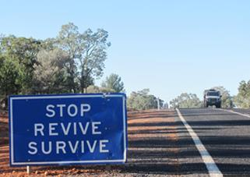
PDO Second Alert: Hipo #10 MVI, 1st March 23, BE/OTO
Date:01/03/2023 Incident title: HiPo#10 Pattern: MVI Potential severity: C5P
Target Audience: Drilling, Logistics, Operation & Construction
What happened?
On 1st March at 8.15am, an HGV driver was on route to Marmul to deliver High Density Polyethylene Duct, the driver started his journey from Haima at 6.01am, three kilometers before Rima roundabout on a straight blacktop road, the OTO driver attempted to overtake another 3rd party truck whilst the 3rd party bus approaching from the oncoming lane, due to heavy fog in the area both drivers were unable to avoid the collision. The 2 vehicles impacted at an angle with the right side of the prime mover striking the right front corner of the bus in a glancing blow before the bus collided with the trailer headboard centre windscreen and both vehicles came to a stop at the right-hand side of the road in the northern direction lane. Consequently, 5 passengers in the bus sustained injuries.
Why it happened/Finding :
Overtaking and failing to apply defensive driving techniques in low visibility foggy road conditions.
Driver fatigue.
Your learning from this incident..
Always drive defensively and avoid overtaking when visibility is limited on the road (e.g. fog conditions).
Always assess the road conditions prior to the start of your journey.
Always inform your journey manager of road hazards that could help others drive safely.
Always ensure you have enough rest prior to driving.
Always ensure your DFMS camera is aligned to your face and report any misalignment immediately.
Overtaking in low visibility, is like driving blindfolded
Notes:
Ensure all dates and titles are input
A short description should be provided without mentioning names of contractors or individuals. You should include, what happened, to who (by job title) and what injuries this resulted in. Nothing more!
Four to five bullet points highlighting the main findings from the investigation. Remember the target audience is the front line staff so this should be written in simple terms in a way that everyone can understand.
The strap line should be the main point you want to get across
The images should be self explanatory, what went wrong (if you create a reconstruction please ensure you do not put people at risk) and below how it should be done.

Slide 2
PDO Second Alert: Hipo #10 MVI, 1st March 23, BE/OTO
Date:01/03/2023 Incident title: HiPo#10 Pattern: MVI Potential severity: C5P
As a learning from this incident and ensure continual improvement all contract managers must review their HSE risk management against the questions asked below
Confirm the following:
Do you ensure your journey planners are taking mitigating actions during adverse weather?
Do you ensure your safe journey management procedure is compliant and proactive?
Do you ensure your fatigue monitoring system alerts are being actioned upon?
Do you ensure your drivers are having sufficient rest?
Do you ensure drivers are learning from previous incidents?
* If the answer is NO to any of the above questions please ensure you take action to correct this finding
Notes:
Ensure all dates and titles are input
Make a list of closed questions (only ‘yes’ or ‘no’ as an answer) to ask others if they have the same issues based on the management or HSE-MS failings or shortfalls identified in the investigation.
Imagine you have to audit other companies to see if they could have the same issues.
These questions should start with: Do you ensure…………………?

