Slide 1
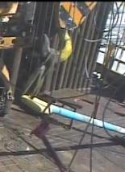
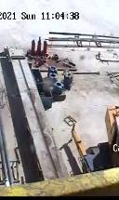
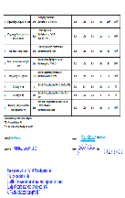
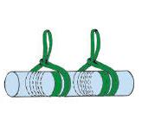
PDO Second Alert
Date: 31.01.2021 Incident title: HiPo#12 DROP
What happened?
On 31st January,2021 @ 11:05 hours, while lowering the third party casing bail at rig floor by using the crane, bail lower end slipped towards v-door on wooden surface (set back area) and hit the V-door gate. V-door gate one part (right side) came out from the hinge and slide down v-door to the ground.
No injury reported
Your learning from this incident..
Always ensure temporary No Go Zone is managed all the times during picking up / laying down activity in the cat-walk area
Always use correct rigging & lifting method while lifting long loads
Always use lift plan and risk assessment to perform any lifting activities ‘’ 10 questions for safe lifting’’
Always use tagline/hands off tools to guide the load
Always keep good communication between banks-man and crane operator.
Always ensure equipment at height having secondary retention
Always use approved lift plan
Ensure lift plan is used to mitigate all hazards and risk involved in the task
Notes:
Ensure all dates and titles are input
A short description should be provided without mentioning names of contractors or individuals. You should include, what happened, to who (by job title) and what injuries this resulted in. Nothing more!
Four to five bullet points highlighting the main findings from the investigation. Remember the target audience is the front line staff so this should be written in simple terms in a way that everyone can understand.
The strap line should be the main point you want to get across
The images should be self explanatory, what went wrong (if you create a reconstruction please ensure you do not put people at risk) and below how it should be done.

Slide 2
Management self audit
Date: 31.01.2021 Incident title: HiPo#12 DROP
As a learning from this incident and ensure continual improvement all contract
managers must review their HSE HEMP against the questions asked below
Confirm the following:
Do you ensure plan in place prior any lifting
Do you ensure task is adequately planned when third parties at site
Do you ensure adequate communication establish between banks man and crane operator
Do you monitor and review the routine activities
Do you ensure all risks are assessed and controlled prior any lifting.
* If the answer is NO to any of the above questions please ensure you take action to correct this finding.
Notes:
Ensure all dates and titles are input
Make a list of closed questions (only ‘yes’ or ‘no’ as an answer) to ask others if they have the same issues based on the management or HSE-MS failings or shortfalls identified in the investigation.
Imagine you have to audit other companies to see if they could have the same issues.
These questions should start with: Do you ensure…………………?

