Slide 1
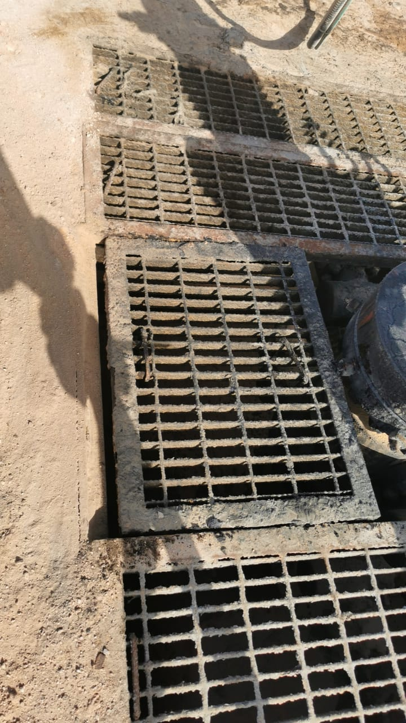
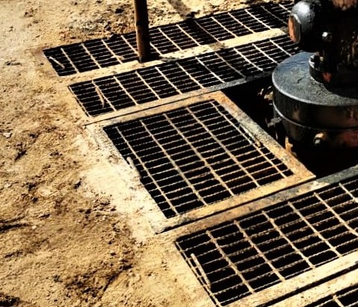
PDO Second Alert
Date:10/02/2022 Incident title: HiPo#13 Pattern: Falling From Height Potential severity: B4P
What happened?
On 10th Feb 2022 @ around 15:15hrs while intending to Rig down BOP the Derrickman intended to release and raise the BOP hose, once he stepped on the middle cellar grating, the cellar grating slipped and he fell with cellar grating into cellar pit (1.4 m) resulted him to hit the wellhead, the IP immediately was taken to Sahara clinic for checks then referred to HAIMA Hospital for further X-ray and than referred to NIZWA Hospital for further investigation.
Why it happened/Finding :
Unsecure cellar grating after nipple up of X-tree
No proper check was done on the cellar grating area
The risk wasn’t identified in the risk assessment
Your learning from this incident:
Always ensure that step by step activity, risk, control and responsibilities are discussed with all involved personnel.
Always consider to Include potential hazard related to cellar in the risk register (HEMP).
Always Communicate the learning to all employees and ensure that all grating are fixed properly.
Always ensure to put your feet in the safe area .
Photo explaining what was done wrong
Photo explaining how it should be done right
Always ensure to put your feet in the safe area
Target Audience: Drilling, Logistics, Operation & Construction
Notes:
Ensure all dates and titles are input
A short description should be provided without mentioning names of contractors or individuals. You should include, what happened, to who (by job title) and what injuries this resulted in. Nothing more!
Four to five bullet points highlighting the main findings from the investigation. Remember the target audience is the front line staff so this should be written in simple terms in a way that everyone can understand.
The strap line should be the main point you want to get across
The images should be self explanatory, what went wrong (if you create a reconstruction please ensure you do not put people at risk) and below how it should be done.

Slide 2
Management self audit
Date:10/02/2022 Incident title: HiPo#13 Pattern: Falling From Height Potential severity: B4P
As a learning from this incident and ensure continual improvement all contract managers must review their HSE risk management against the questions asked below
Confirm the following:
- Do you ensure that the cellar grating is safe and secured to walk , work or stand?
- Do ensure that the pre-check inspection is conducted properly?
- Do you ensure the risk of falling into the cellar is included in your risk register?
- Do you ensure that pre-check done if any change during the operation ?
- Do ensure that all hazard are captured on the TBT and TRIC ,JSA ?
* If the answer is NO to any of the above questions please ensure you take action to correct this finding
Notes:
Ensure all dates and titles are input
Make a list of closed questions (only ‘yes’ or ‘no’ as an answer) to ask others if they have the same issues based on the management or HSE-MS failings or shortfalls identified in the investigation.
Imagine you have to audit other companies to see if they could have the same issues.
These questions should start with: Do you ensure…………………?

