Slide 1
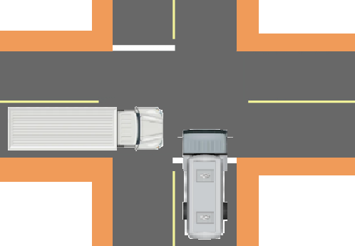
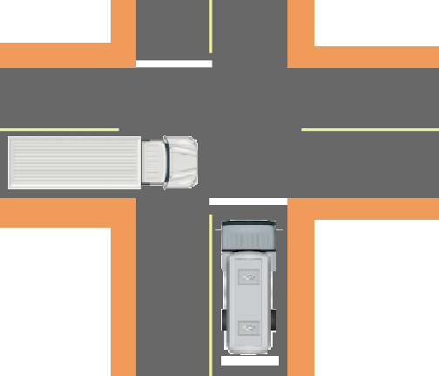
PDO Second Alert
Date:03/04/2023 Incident title: HiPo#16 Pattern: MVI Potential severity: D4 (P) Activity: Driving
Target Audience: Drilling, Logistics, Operation & Construction
What happened?
On 03rd April 23 at 10:27 hrs, a motor vehicle incident happened at the road intersection in front of Marmul B station involving a Vacuum Tanker and HGV tipper. The HGV tipper was coming from Marmul direction and the vacuum tanker was coming from Marmul A station direction. Both vehicles were involved in a collision at the intersection, resulting in vehicle damage to both vehicles. The HGV tipper driver has the right of way, but the VT driver did not stop at the intersection with the STOP Signboard and did not give way. No injury to both drivers only asset damages to the vehicles.
Why it happened/Finding :
Lack of Identifying distraction from personal problems and fatigue of employees.
Did not apply defensive driving techniques. Failed to STOP at the intersection with the STOP Signboard.
Non-compliance with SP2000 DD Permit. Operator who drove the VT does not have DD04 Permit.
Lack of Supervision and Management. Failed to supervise, failed to train and mentor the new employees and subcontractors.
Your learning from this incident..
Always stay alert while driving-if you feel fatigued/tired or distracted, STOP and contact the Journey Manager.
Always apply defensive driving techniques by following road signboards such as STOP or YIELD at intersections or junctions.
Always ensure you have a valid driving license and driving permit for the type of vehicle you intend to drive
Always ensure adequate and competent supervision is provided in your workplace.
Always look ahead to the road to assess any signboards, road hazards, and changes to road conditions.
Photo explaining what was done wrong
Vehicle Collision
Photo explaining how it should be done right
STOPPING at Intersections with STOP Signboards prevents accidents
STAY Alert. Avoid Fatigue. STOP at Intersections with STOP Signboards.
Notes:
Ensure all dates and titles are input
A short description should be provided without mentioning names of contractors or individuals. You should include, what happened, to who (by job title) and what injuries this resulted in. Nothing more!
Four to five bullet points highlighting the main findings from the investigation. Remember the target audience is the front line staff so this should be written in simple terms in a way that everyone can understand.
The strap line should be the main point you want to get across
The images should be self explanatory, what went wrong (if you create a reconstruction please ensure you do not put people at risk) and below how it should be done.

Slide 2
Management self audit
Date:03/04/2023 Incident title: HiPo#16 Pattern: MVI Potential severity: D4 (P) Activity: Driving
As a learning from this incident and ensure continual improvement all contract managers must review their HSE risk management against the questions asked below
Confirm the following:
How do you ensure your drivers are alert and in good condition before driving? How do you identify distractions from personal issues from family or at work?
How do you ensure your company has established and implemented an effective Fatigue Management System?
How do you ensure your drivers are following defensive driving techniques by slowing down and stopping at road intersections and by following signboards?
How do you ensure your drivers are authorized to drive and complying valid driving licenses and driving permits for vehicles they intend to use?
How do you ensure you have adequate and competent supervision in your workplace?
* If the answer is NO to any of the above questions please ensure you take action to correct this finding
Notes:
Ensure all dates and titles are input
Make a list of closed questions (only ‘yes’ or ‘no’ as an answer) to ask others if they have the same issues based on the management or HSE-MS failings or shortfalls identified in the investigation.
Imagine you have to audit other companies to see if they could have the same issues.
These questions should start with: Do you ensure…………………?

