Slide 1
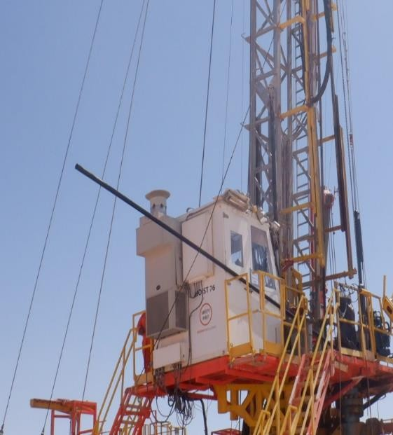
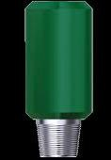
PDO Second Alert
Date: 02/03/2022
Incident title: HiPo # 20
Pattern: Dropped Object
Target Audience: Drilling / Hoists – Rig Managers, Night Tool pusher and Drillers
Potential severity: C4P
What happened?
The operation was POOH and Lay down 2-7/8” HT PAC Pipe (length 9.6m). The Driller raised the 2nd joint of 2-7/8” HT PAC pipe (weight - 156kg) , set slips and broke out the connection. As the Driller was raising the joint to lay down to the Catwalk, the 2-7/8” HT PAC pipe dislodged from the elevator causing the joint to fall to the Rig Floor from a height of approximately 1.2 m. Crew immediately secured the well and stopped the operation.
Zone management was enforced. No injuries were sustained.
Why it happened/Finding :
No inspection of 2-7/8” HT PAC prior to RIH
Zone management was in place
The 2-7/8” HT PAC joint worn and undersized
The 2-7/8” HT PAC joint had no identification number or markings
Correct center latch Slip type elevators were being used
SOP Not available for POOH 2-7/8” HT PAC
No crossover used as secondary retention
Pipe Tally requirements not followed
Your learning from this incident..
Ensure all pipes are visually inspected prior to use
Ensure pipe tally requirements are completed and verified
Ensure all inspection certificates are readily available
Ensure SOPs are available and reviewed prior to task
Ensure during all RIH / POOH 2-7/8’’ HT PAC pipe a X-Over is utilized as a secondary retention
During RIH / POOH 2-7/8’’ HT PAC pipe, X-Over must be used as a secondary retention

Slide 2
Management self audit
Date: 02/03/2022
Incident title: HiPo # 20
Pattern: Dropped Object
Potential severity: C4P
As a learning from this incident and ensure continual improvement all contract managers must review their HSE risk management against the questions asked below
Confirm the following:
Do you have an effective TBT with TRIC and JSA to cover all the hazards / risks and controls for the task?
Do you ensure full inspection of equipment prior to use?
Do you have effective shared assets system in your organization?
Do you empower the site leadership to intervene and ensure stop work authority (SWA) is enforced when they witness any mishandling of equipment or incorrect usage of tools?
Do you have an effective audit/assurance process to identify shortfalls in your risk management tool, JSA or SOP?
Do you ensure LFI from past similar incidents are widely shared across all levels in the organization especially with site leadership teams, and that effectiveness of understanding is assured?
* If the answer is NO to any of the above questions please ensure you take action to correct this finding

