Slide 1
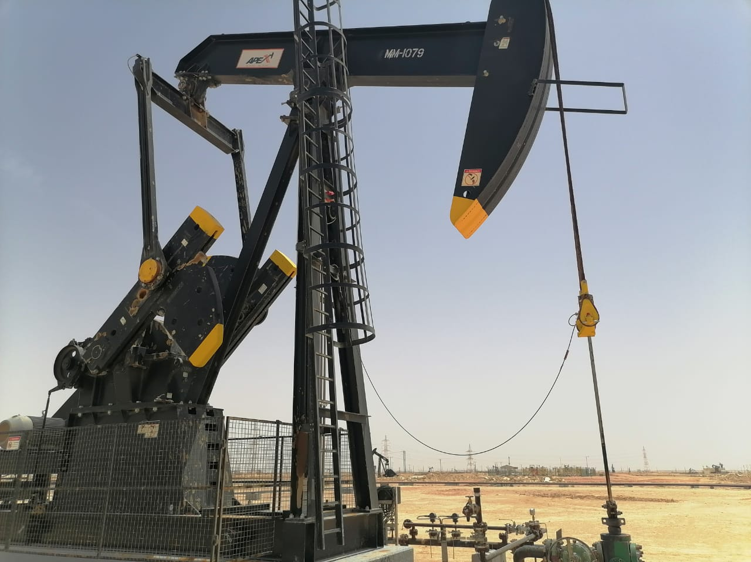
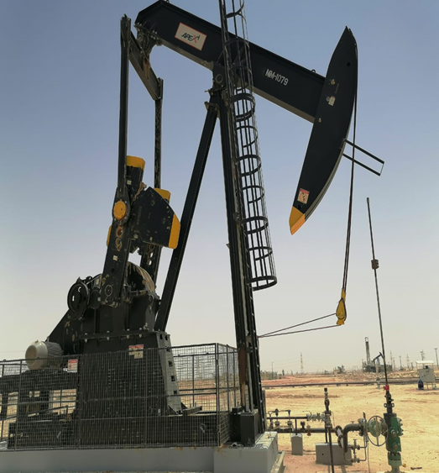
PDO Second Alert
Date:26/06/2023 Incident title: HiPo#28 Pattern: Asset Damage Potential severity: C4P Activity: Beam Pump Corrective Maintenance – Wrist Pin Replacement.
Target Audience: Drilling, Logistics, Operation & Construction
Photo explaining what was done wrong
What happened?
On 26th June 2023 at around 0850hrs, while the damaged wrist pin was being replaced by the maintenance crew on the beam pump at well ID: Marmul-080, the walking beam with the horse head fell down and hit the stuffing box on the wellhead.
Why it happened/Finding :
The Corrective Maintenance (CM) procedure and CM procedure checklist were not available with the crew.
Downhole force/load/weight was not isolated
Your learning from this incident..
Always ensure the Corrective Maintenance (CM) procedure and CM procedure checklist are available with the crew.
Always ensure the downhole load is isolated before any intervention with the Beam Pumping Unit
Always conduct Periodic technical refreshment sessions for CM activities involving all crew members.
Always conduct quality spot checks for procedure availability and compliance while the crew is at work.
Photo explaining how it should be done right
Ensure the relevant procedures are available with crew.
Notes:
Ensure all dates and titles are input
A short description should be provided without mentioning names of contractors or individuals. You should include, what happened, to who (by job title) and what injuries this resulted in. Nothing more!
Four to five bullet points highlighting the main findings from the investigation. Remember the target audience is the front line staff so this should be written in simple terms in a way that everyone can understand.
The strap line should be the main point you want to get across
The images should be self explanatory, what went wrong (if you create a reconstruction please ensure you do not put people at risk) and below how it should be done.

Slide 2
Management self audit
Date: 26/06/2023 Incident title: HiPo#28 Pattern: Asset Damage Potential severity: C4P Activity: Beam Pump Corrective Maintenance – Wrist Pin Replacement.
Confirm the following:
Do you ensure the Corrective Maintenance (CM) procedure and CM procedure checklist are available with the crew.
Do you ensure the downhole load is isolated before any intervention with the Beam Pumping Unit
Do you ensure that the Periodic technical refreshment sessions for CM activities are conducted involving all crew members.
Do you ensure that quality spot checks are conducted for procedure availability and compliance while the crew is at work.
Do you ensure that the emergency number (2438-5555) is called in every incident?
* If the answer is NO to any of the above questions, please ensure you take action to correct this finding
Notes:
Ensure all dates and titles are input
Make a list of closed questions (only ‘yes’ or ‘no’ as an answer) to ask others if they have the same issues based on the management or HSE-MS failings or shortfalls identified in the investigation.
Imagine you have to audit other companies to see if they could have the same issues.
These questions should start with: Do you ensure…………………?

