Slide 1
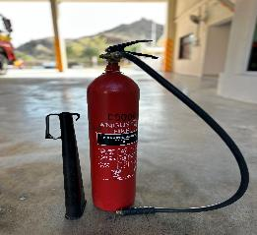
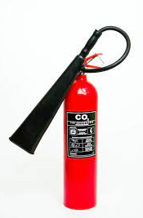
PDO Second Alert
Date: 08/01/2023 Incident title: HiPo#3 Pattern: Line of fire Potential severity: B4P Activity: Fire Warden Training
Target Audience: Drilling, Logistics, Operation & Construction
What happened?
That an accident had occurred at the Mina Al Fahal (MAF) Fire Station. The incident involved a firefighter sustaining an injury to his stomach whilst demonstrating the use of an extinguisher whilst participating in a Fire Warden Training Session.
The 5kg Carbon Dioxide extinguisher plastic horn detached violently from the extinguisher supply hose. The pressurized hose connection recoiled causing the injury.
Why it happened/Finding :
Cracked horn connection to the extinguisher supply hose.
No pre inspection of the extinguisher or oversight checks being carried out
You're learning from this incident..
Ensure fire extinguishers are visually inspect prior use to identify defect and replaced as required.
Damaged extinguisher clearly labelled and put into quarantine.
A full oversight of the third-party maintenance, testing and inspections are to be carried
Photo explaining what was done wrong
Photo explaining how it should be done right
Check all your equipment before use
Notes:
Ensure all dates and titles are input
A short description should be provided without mentioning names of contractors or individuals. You should include, what happened, to who (by job title) and what injuries this resulted in. Nothing more!
Four to five bullet points highlighting the main findings from the investigation. Remember the target audience is the front line staff so this should be written in simple terms in a way that everyone can understand.
The strap line should be the main point you want to get across
The images should be self explanatory, what went wrong (if you create a reconstruction please ensure you do not put people at risk) and below how it should be done.

Slide 2
Management self audit
Date: 08/01/2023 Incident title: HiPo#3 Pattern: Line of fire Potential severity: B4P Activity: Fire Warden Training
As a learning from this incident and ensure continual improvement all contract managers must review their HSE risk management against the questions asked below
Confirm the following:
Do you ensure that the proper inspection and maintenance programs in place and carried our regularly?
Do you ensure that all fire team are aware that extinguishers should be visually checked prior to their use?
Do you ensure that fire extinguishers on all sites have records of their extinguisher locations and up to date inventories of numbers and types?
* If the answer is NO to any of the above questions please ensure you take action to correct this finding
Notes:
Ensure all dates and titles are input
Make a list of closed questions (only ‘yes’ or ‘no’ as an answer) to ask others if they have the same issues based on the management or HSE-MS failings or shortfalls identified in the investigation.
Imagine you have to audit other companies to see if they could have the same issues.
These questions should start with: Do you ensure…………………?

