Slide 1
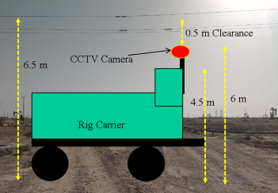
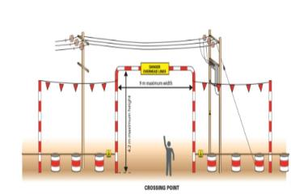
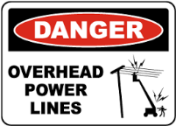
PDO Second Alert
Date: 07.06.2021 Incident Type: HiPo#32A- OHL
What happened?
Date 07-06-2021 @ 13:44hours, Rig move was carried out from MM-674 to the next location in the day light condition (13:44 Hrs). Rig carrier and hoist trailers crossed underneath 33 KV Overhead powerline to its close proximity of 0.5 Mtr. clearance.
No electrocution or asset damage occurred during this activity
Your learning from this incident..
Always ensure to perform adequate hoist move route survey and capture all necessary elements. Discuss with crew during TBT
Always ensure to execute the work as per SOP.
Always maintain the minimum safety clearance of OHL corresponding to its KV (132/66/33)
Always obtain clearance certificate from concern dept. when max load height exceeds 5M or OHL height is unknown
Always ensure to strip down the extended loads prior rig move.
Always fully adhere to the passing below OHL requirements
Notes:
Ensure all dates and titles are input
A short description should be provided without mentioning names of contractors or individuals. You should include, what happened, to who (by job title) and what injuries this resulted in. Nothing more!
Four to five bullet points highlighting the main findings from the investigation. Remember the target audience is the front line staff so this should be written in simple terms in a way that everyone can understand.
The strap line should be the main point you want to get across
The images should be self explanatory, what went wrong (if you create a reconstruction please ensure you do not put people at risk) and below how it should be done.

Slide 2
Management self audit
Date: 07.06.2021 Incident Type: HiPo#32A- OHL
As a learning from this incident and ensure continual improvement all contract
managers must review their HSE HEMP against the questions asked below
Confirm the following:
Do you ensure all hazards and risk mitigation for rig move activity are covered during your TBT?
Do you ensure that adequate Route surveys are undertaken prior rig move?
Do you ensure all OHL heights & max load heights are measured during route survey?
Do you ensure additional extended loads are stripped down from trailers prior move?
Do you ensure to obtain clearance certificate from authorities for load height exceeding 5 m?
Do you ensure that SOP and Risk assessment are followed adequately for operation?
* If the answer is NO to any of the above questions please ensure you take action to correct this finding.
Notes:
Ensure all dates and titles are input
Make a list of closed questions (only ‘yes’ or ‘no’ as an answer) to ask others if they have the same issues based on the management or HSE-MS failings or shortfalls identified in the investigation.
Imagine you have to audit other companies to see if they could have the same issues.
These questions should start with: Do you ensure…………………?

