Slide 1
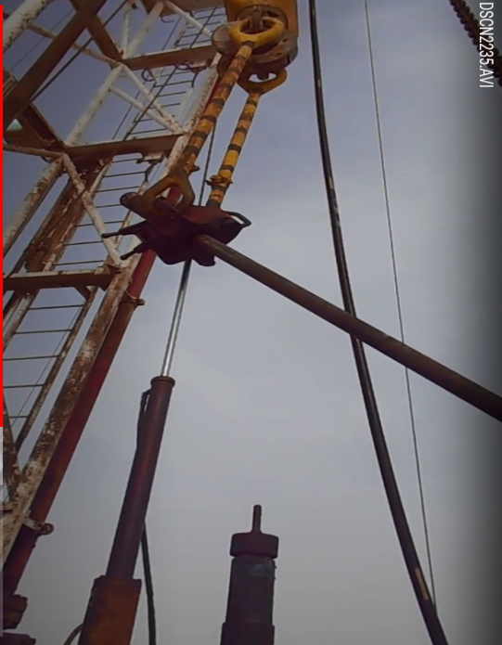
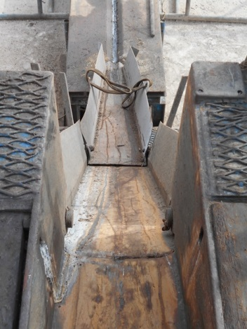
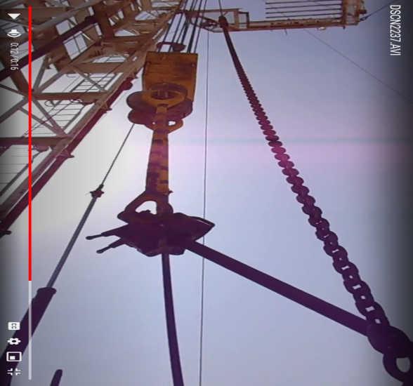
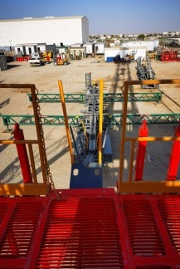
PDO Second Alert
Date: 24/07/2021 Incident title: HIPO #40 Drop
What happened?
The POOH of Polish mill assembly on 3 ½ IF DP string was in progress. At around
13.45 (24.07.) the 23rd joint was B/O with power tong and while laying the joint down the V-Door the Elevator suddenly opened when it was approx. 2.5mtrs above the rig floor. The joint was already in the V-Door with its half length once the elevator opened and the joint uncontrollably slid down the V-Door and rested on the right side of the pipe racks.
Your learning from this incident..
-Always Comply to Drops zone management, utilize step back safety zone whenever possible
Always Observe the path of the elevator while tripping and during laying down the Tubular thru the V-Door (Tubular smooth motion)
Always Ensure the Elevator is properly latched (Floorman to “thumb up” to the driller prior to picking the string)
Straight line V-Doors is preferred , always inspect the equipment pre use, check the condition of the V-Door and catwalk groove
-
Ensure no objects come in contact with Elevator while in motion.
Notes:
Ensure all dates and titles are input
A short description should be provided without mentioning names of contractors or individuals. You should include, what happened, to who (by job title) and what injuries this resulted in. Nothing more!
Four to five bullet points highlighting the main findings from the investigation. Remember the target audience is the front line staff so this should be written in simple terms in a way that everyone can understand.
The strap line should be the main point you want to get across
The images should be self explanatory, what went wrong (if you create a reconstruction please ensure you do not put people at risk) and below how it should be done.

Slide 2
Management self audit
Date: 24/07/2021 Incident title: HIPO #40 Drop
As a learning from this incident and ensure continual improvement all contract
managers must review their HSE HEMP against the questions asked below
Confirm the following:
Do you ensure Compliance to Drops zone management and utilize step back safety zone whenever possible?
Do you ensure the Tubular slides down the V-Door in a smooth motion ?
Do you ensure nothing comes in contact with the Elevator after it is latched and in motion?
Do you ensure your supervisory staff up to the level to manage risks and hazards efficiently ?
Do you ensure the v-door condition is part of annual inspections as per the PMS system?
* If the answer is NO to any of the above questions please ensure you take action to correct this finding.
Notes:
Ensure all dates and titles are input
Make a list of closed questions (only ‘yes’ or ‘no’ as an answer) to ask others if they have the same issues based on the management or HSE-MS failings or shortfalls identified in the investigation.
Imagine you have to audit other companies to see if they could have the same issues.
These questions should start with: Do you ensure…………………?

