Slide 1
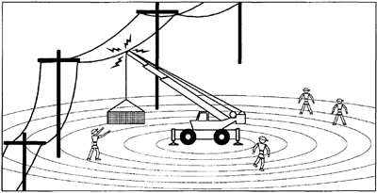
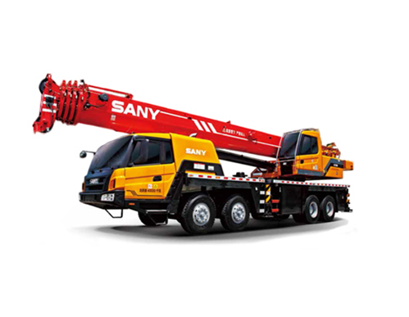
PDO Second Alert
Date: 31.07.2021 Incident title: HiPo#41
What happened?
At 17.15 hrs, the crane operator moved his crane with the raised boom to offload a 20 ft container from the trailer (the trailer was parked outside the Rig 38 rig pad). While positioning the crane, the wire ropes (32 mm x 9m) attached to the crane hook block made contact with the overhead powerline, which was passing in the vicinity.
Your learning from this incident..
Always ensure boom of the crane is lowered and slings are removed during moving of the crane.
Always operate the crane after receiving the signal from banks man.
Always ensure all rig move team participates in TBT and on-site supervision is provided.
Always ensure equipment are spotted away from vicinity of overhead powerlines.
Always ensure out of site register is updated with rig move activities.
Always maintain safe clearance from Over Head Lines
Always be cautious about proximity hazards of overhead lines whilst operating crane
Notes:
Ensure all dates and titles are input
A short description should be provided without mentioning names of contractors or individuals. You should include, what happened, to who (by job title) and what injuries this resulted in. Nothing more!
Four to five bullet points highlighting the main findings from the investigation. Remember the target audience is the front line staff so this should be written in simple terms in a way that everyone can understand.
The strap line should be the main point you want to get across
The images should be self explanatory, what went wrong (if you create a reconstruction please ensure you do not put people at risk) and below how it should be done.

Slide 2
Management self audit
Date: 31.07.2021 Incident title: HiPo#41
As a learning from this incident and ensure continual improvement all contract
managers must review their HSE HEMP against the questions asked below
Confirm the following:
Do you ensure third party crane operating in the vicinity of powerline covered in out of sight register?
Do you ensure crane operators are not taking any short cuts?
Do you ensure all rig move team are attending TBT?
Do you ensure rig move parties are following procedures?
* If the answer is NO to any of the above questions please ensure you take action to correct this finding.
Notes:
Ensure all dates and titles are input
Make a list of closed questions (only ‘yes’ or ‘no’ as an answer) to ask others if they have the same issues based on the management or HSE-MS failings or shortfalls identified in the investigation.
Imagine you have to audit other companies to see if they could have the same issues.
These questions should start with: Do you ensure…………………?

