Slide 1
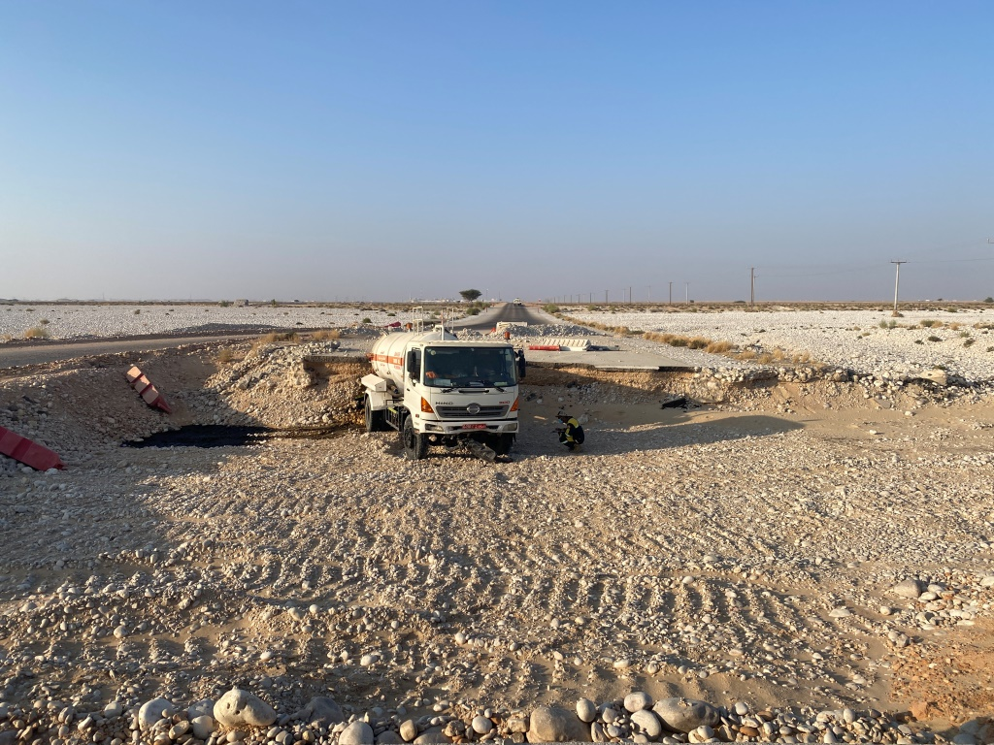
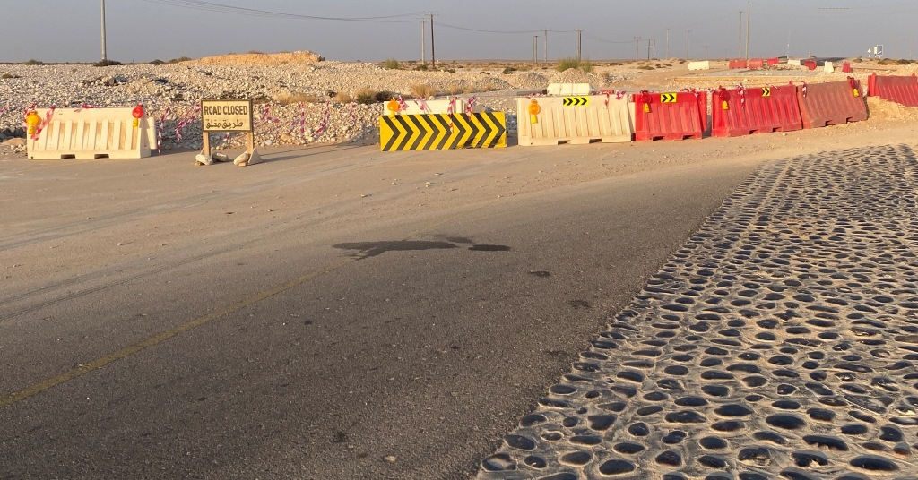
PDO Second Alert
Date:04/12/2021 Incident title: HiPo#65 A Pattern: MVI Potential severity: C4P
Target Audience: Drilling, Logistics, Operation & Construction
What happened?
On 04.12.2021 at around 05:50 hrs AIP subcontractor (RNTC) vacuum tanker bearing Reg#6490 YS was travelling from HMPS to AIP camp with partially filled jet cleaned oily water. At approx. 4 kms away from HMPS, the road diversion (damaged section of road due to cyclone Mekunu in 2018) area, the tanker drove straight instead of following diversion and landed into the existing dry wadi.
Why it happened/Finding :
Vehicle’s electrical system malfunctioned causing the lights to go off few seconds prior to the incident; this caused distraction of driver focus from the road.
Physical barriers and signs to warn vehicles approaching towards the damaged road section were not adequate.
Temporary road diversion provided is not signposted to guide the road users; no physical measures (eg: signs, lighting, speed breaker, flashing lights) to slow down the approaching vehicles (only sign board, 350 m before the incident location indicating road speed as 80 kmph).
The damaged road section (eroded by wadi flooding during 2018 Cyclone Mekhnu) remained uncorrected till date exposing the road users to this hazard.
Your learning from this incident..
Always be within safe speed limits that make control easier in unexpected situations.
Stop the vehicle immediately and check if any malfunction occurs in the vehicle while driving
Always follow defensive driving and be observant of the road signs
Always watch for hazards on the road and be prepared to act defensively
Always call PDO emergency number (5555) immediately after an incident
Report any hazards / road damages observed to PDO for its timely rectification
Ensure proper functioning of the IVMS by actually logging in to the system, not just rely on starting of engine without IVMS key / card.
Notes:
Ensure all dates and titles are input
A short description should be provided without mentioning names of contractors or individuals. You should include, what happened, to who (by job title) and what injuries this resulted in. Nothing more!
Four to five bullet points highlighting the main findings from the investigation. Remember the target audience is the front line staff so this should be written in simple terms in a way that everyone can understand.
The strap line should be the main point you want to get across
The images should be self explanatory, what went wrong (if you create a reconstruction please ensure you do not put people at risk) and below how it should be done.

Slide 2
Management self audit
Date:04/12/2021 Incident title: HiPo#65 A Pattern: MVI Potential severity: C4P
As a learning from this incident and ensure continual improvement all contract managers must review their HSE risk management against the questions asked below
Confirm the following:
Do you ensure your drivers / crew provide feedback on the road conditions encountered?
Do you ensure the feedback obtained from drivers / crews related road conditions are communicated and addressed appropriately?
Do you ensure your drivers are communicated and remain updated of the road conditions in the area of operation?
Do you ensure by logging into the system that the IVMS fitted in the vehicle is functioning as required?
Do you ensure your drivers / crews are aware of their empowerment to stop unsafe work?
* If the answer is NO to any of the above questions please ensure you take action to correct this finding
Notes:
Ensure all dates and titles are input
Make a list of closed questions (only ‘yes’ or ‘no’ as an answer) to ask others if they have the same issues based on the management or HSE-MS failings or shortfalls identified in the investigation.
Imagine you have to audit other companies to see if they could have the same issues.
These questions should start with: Do you ensure…………………?

