Slide 1
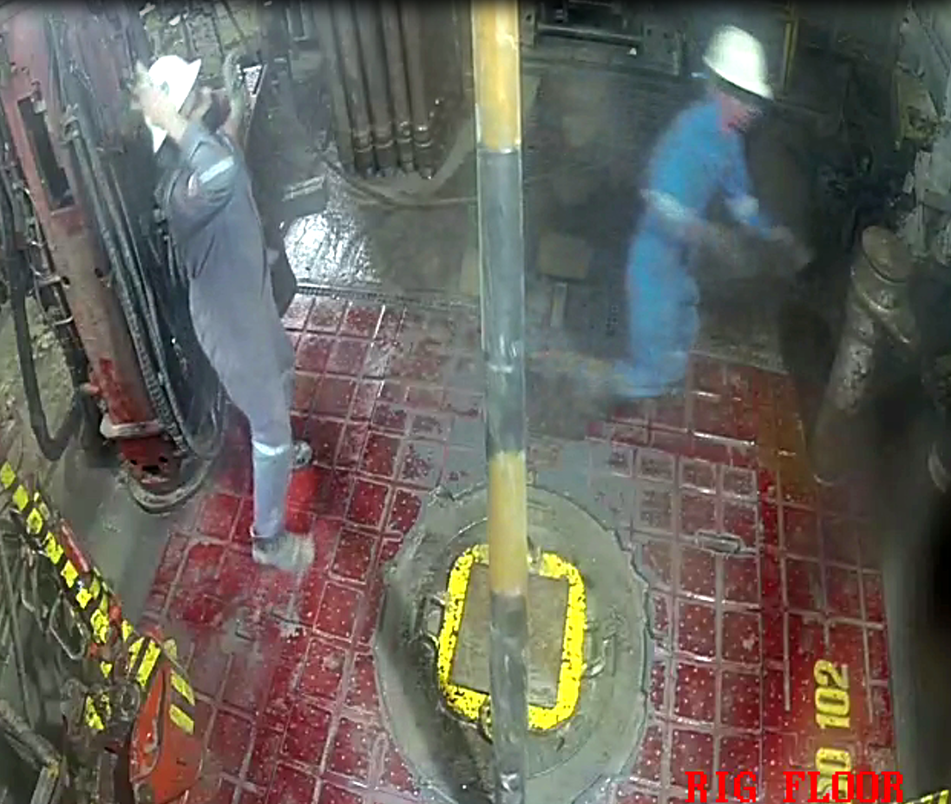
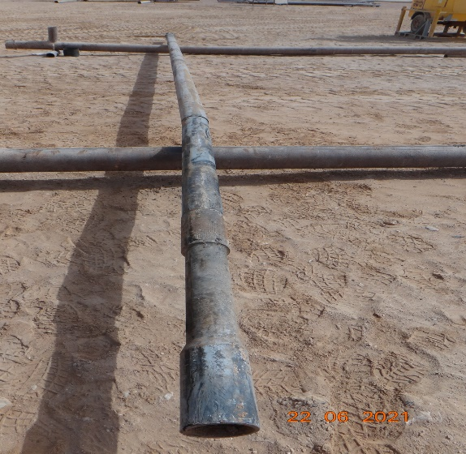
PDO Second Alert
Date: 22.06.2021 Incident type: HiPo#33
What happened?
After finishing making up 6 1/8" bit with the motor, the driller lifted the whole assembly by BX Elevator then pushed towards Drawworks/Mud tanks side and rested it on the rotary mat to allow the crew to remove the bit breaker by winch from well center. While winch was being prepared to lift the bit breaker, the BX elevator opened and as a result, the drilling assembly which was in a tilted position fell on the rig floor (between the DPs setback and adjacent V door post) and bounced off the rig floor and fell into the ground. Motor got bent, No injury to Personnel.
Your learning from this incident..
▪ Ensure Driller and crew are fully concentrated during operation and while dealing with equipment.
▪ Ensure to keep attention to signs of fatigue during crew changes and manage them.
▪ Ensure good communication between Driller & Crew.
▪ It is safer to keep the elevator door against the inclination of the assembly in case the elevator opens,
the assembly will remain in the elevator housing due to tool inclination.
▪ Keep weight on elevator (don’t slack off the full weight) to allow mechanism of locking pin engaged.
Observe fatigue during crew change-Empower to Stop
Make sure the crew are focused during the operation
Notes:
Ensure all dates and titles are input
A short description should be provided without mentioning names of contractors or individuals. You should include, what happened, to who (by job title) and what injuries this resulted in. Nothing more!
Four to five bullet points highlighting the main findings from the investigation. Remember the target audience is the front line staff so this should be written in simple terms in a way that everyone can understand.
The strap line should be the main point you want to get across
The images should be self explanatory, what went wrong (if you create a reconstruction please ensure you do not put people at risk) and below how it should be done.

Slide 2
Management self audit
Date: 22.06.2021 Incident type: HiPo#33
As a learning from this incident and ensure continual improvement all contract
managers must review their HSE HEMP against the questions asked below
Confirm the following:
Do you ensure your team has empowerment to STOP?
Do you have Fatigue management plan on your site?
Do you have Fatigue awareness training for your crews?
Do you ensure your team understands the limitation of the interlocks system?
* If the answer is NO to any of the above questions please ensure you take action to correct this finding.
Notes:
Ensure all dates and titles are input
Make a list of closed questions (only ‘yes’ or ‘no’ as an answer) to ask others if they have the same issues based on the management or HSE-MS failings or shortfalls identified in the investigation.
Imagine you have to audit other companies to see if they could have the same issues.
These questions should start with: Do you ensure…………………?

