Slide 1
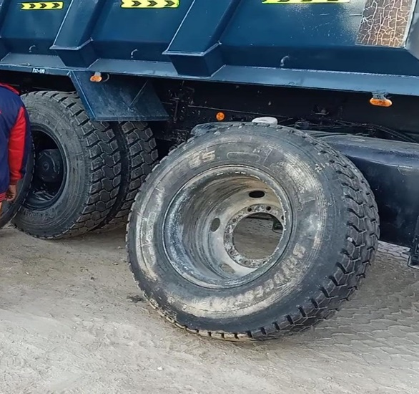
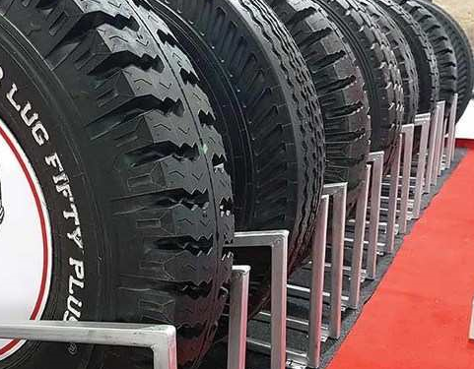
PDO Second Alert
Date: 11.01.2021 Incident title : LTI -02
What happened?
Tyreman was carrying out fixing the tyre of the tipper meanwhile the driver rotated the standby tyre which was kept leaning towards the truck for filling of air. After filling, the driver stood close to the same tyre and was observing the Tyreman's activity. Suddenly the standby wheel fell on the driver’s lower leg resulted in pain, swelling and restricted movement of the right lower leg.
Your learning from this incident..
Always stay away from restricted areas.
Always ensure the objects are kept in stable position.
Avoid unauthorized or unassigned work in workshops.
Always Intervene when you notice unsafe action.
Always ensure adequate supervision.
Ensure drivers utilize the waiting rooms in workshops to rest during short maintenance activities.
Do not leave loads / Heavy equipment parts unrestrained
Notes:
Ensure all dates and titles are input
A short description should be provided without mentioning names of contractors or individuals. You should include, what happened, to who (by job title) and what injuries this resulted in. Nothing more!
Four to five bullet points highlighting the main findings from the investigation. Remember the target audience is the front line staff so this should be written in simple terms in a way that everyone can understand.
The strap line should be the main point you want to get across
The images should be self explanatory, what went wrong (if you create a reconstruction please ensure you do not put people at risk) and below how it should be done.

Slide 2
Management self audit
Date: 11.01.2021 Incident title: LTI# 02
As a learning from this incident and ensure continual improvement all contract
managers must review their HSE HEMP against the questions asked below
Confirm the following:
Do you ensure visitors to workshops follow work instruction fundamentals?
Do you ensure your assurance checks on procedures are present, adequate and effective for out of site locations?
Do you ensure that workers are educated to stay away from line of fire ?
Do you ensure that employees do not to carryout unauthorized activity ?
Do you ensure hazards are identified for the task you performing?
Do you ensure that employees are made aware to intervene in unsafe action ?
Do you ensure LFI are cascaded and regularly discussed during the HSE meetings ?
* If the answer is NO to any of the above questions please ensure you take action to correct this finding.
Notes:
Ensure all dates and titles are input
Make a list of closed questions (only ‘yes’ or ‘no’ as an answer) to ask others if they have the same issues based on the management or HSE-MS failings or shortfalls identified in the investigation.
Imagine you have to audit other companies to see if they could have the same issues.
These questions should start with: Do you ensure…………………?

