Slide 1
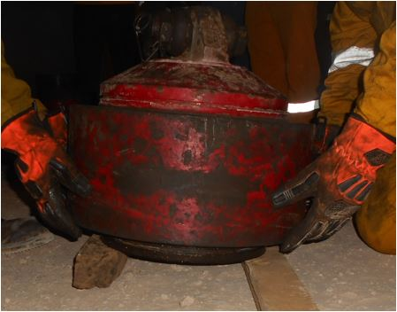
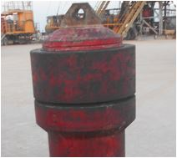
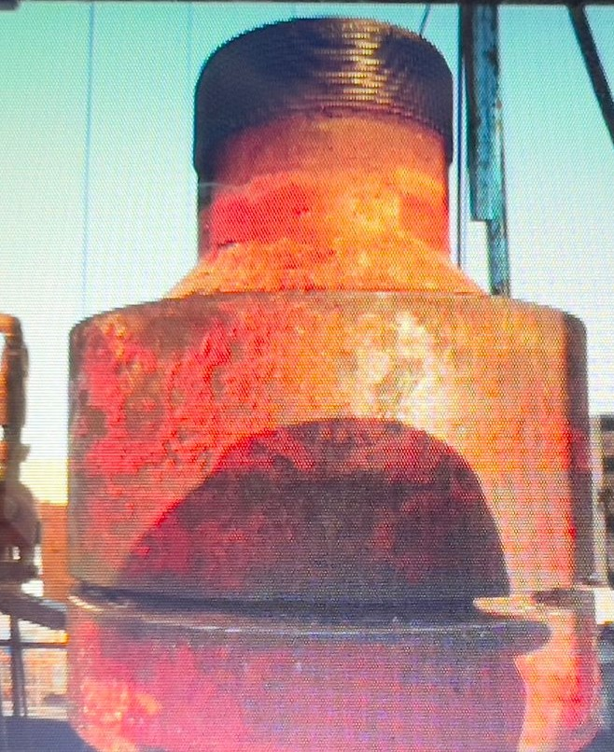
PDO Second Alert
Date:21/03/2022 Incident title: LTI #7 Pattern: MVI, Drops and OHL. Potential severity: C3P
Target Audience: Driller, AD, Derrick man
What happened?
After Pressure Testing (PT) the 11”-5K shooting nipple, Derrick man and FM unscrew the ACME coupling of the Pressure Testing (PT) cap, pick it up to the RF using the winch and remove the ACME coupling from the PT cap by hands from below. They laid down the ACME coupling on the RF and picked from the top side. When they tried to install it on the shooting nipple Crossover (XO); the ACME coupling slipped from the FM side and the DM middle finger got trapped between the ACME coupling and the shooting nipple Crossover (XO).
Why it happened/Finding :
SOP is not available for the activity
Pinch points were not identified and marked
Same coupling was used for pressure testing of the shooting nipple cap and on the shooting nipple crossover.
Impact gloves were used during the activity
Generic TBT and TRIC Card was done but not specific to the task.
Your learning from this incident..
Never perform the task without approved SOP for shooting nipple activity
Always carryout specific TBT and TRIC card for shooting nipple activity
Always use specific coupling for each element (PT and XO)
Always make sure all the required materials for the job is on site before the job.
Always use specific coupling for each element
Notes:
Ensure all dates and titles are input
A short description should be provided without mentioning names of contractors or individuals. You should include, what happened, to who (by job title) and what injuries this resulted in. Nothing more!
Four to five bullet points highlighting the main findings from the investigation. Remember the target audience is the front line staff so this should be written in simple terms in a way that everyone can understand.
The strap line should be the main point you want to get across
The images should be self explanatory, what went wrong (if you create a reconstruction please ensure you do not put people at risk) and below how it should be done.

Slide 2
Management self audit
Date:21/03/2022 Incident title: LTI #7 Pattern: MVI, Drops and OHL. Potential severity: C3P
As a learning from this incident and ensure continual improvement all contract managers must review their HSE risk management against the questions asked below
Confirm the following:
Do you ensure that the there is an approved SOP for shooting nipple activity?
Do you ensure specific TBT and TRIC card are carried out for shooting nipple activity?
Do you always use specific coupling for each element (Pressure Testing and Crossover)?
Do you ensure an effective process of managing materials / equipment received from PDO and third party?
* If the answer is NO to any of the above questions please ensure you take action to correct this finding
Notes:
Ensure all dates and titles are input
Make a list of closed questions (only ‘yes’ or ‘no’ as an answer) to ask others if they have the same issues based on the management or HSE-MS failings or shortfalls identified in the investigation.
Imagine you have to audit other companies to see if they could have the same issues.
These questions should start with: Do you ensure…………………?

